Slide 1
Front End Engineering-I Project
Team Details:
Keshav Bhalla(2310991869)
Kavita Sharma(2310991868)
Kashish Sharma(2310991867)
Faculty Coordinator:
Dr. Bhisham Sharma
:
Chitkara University Institute of Engineering and Technology,
Chitkara University, Punjab

Slide 2
Table of Contents
Introduction
Problem Statement
Technical Details
Key Features
Project Highlights
Bonus Feature(optional)
Conclusion
References/Links used

Slide 3
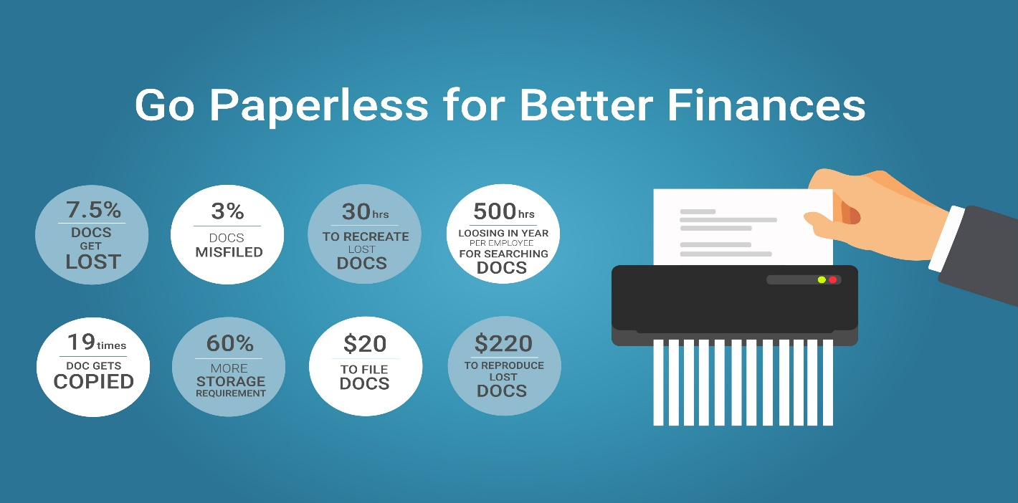
Introduction
The Title Of the project is “Personal Finance manager”. The team members are:
1)Keshav Bhalla(2310991869)
2)Kavita Sharma(2310991868)
3)Kashish Sharma(2310991867)
The purpose of the project is to help our website user to reach their future financial goal whether it is to buy a home in future or do a bigger investment in different plots or to resolve their financial status problems.
Our user can have a talk with the most professional finance managers on our website who are ready to help them eagerly.

Slide 4
Problem Statement
There are two main problems solved by our website:
First , is to help our website user to reach their future financial goal . For example a person thinks of buying a house in future and his current financial situation is not as good to meet the requirements for this goal . So he can register with us so that we can help him and many more others like him to rectify problems that are stopping them to reach their financial goal.
But why choose our website if a personal finance manger can help them in his/her office? Answer is simple: ‘Paperload’ . Even though a person can reach out to a finance manager for different solutions to their problems but their might a lot of paperwork involved and lot of travelling might be involved in this task . So rather than this , why not spend valuable time to your manage your money by sitting just at home , avoiding paperwork and using a user friendly graphics website which is easy to use.

Slide 5


Technical Details
As we have got this project under the subject ‘FRONT END ENGINEERING’ we have mainly used HTML AND CSS in our project.
Also we have used Visual Studio code to write our Html and CSS Codes .
In this project we have mainly used the following tags:
Title tag
Division Tags
Anchor tags
Hyper reference links
Image tags
Video tags
Font Tags
Paragraph Tags
<hr> Tag
Marquee Tag
Heading tag
Footer tag
Table Tag
External CSS
Internal CSS
Inline CSS
Bootstrap
Javascript

Slide 6
Technical Details
The HyperText Markup Language or HTML is the standard markup language for documents designed to be displayed in a web browser. It defines the meaning and structure of web content.
Cascading Style Sheets is a style sheet language used for describing the presentation of a document written in a markup language such as HTML or XML.
Bootstrap is a free and open-source CSS framework directed at responsive, mobile-first front-end web development. It contains HTML, CSS and JavaScript-based design templates for typography, forms, buttons, navigation, and other interface components.
JavaScript (JS) is a cross-platform, object-oriented programming language used by developers to make web pages interactive. It allows developers to create dynamically updating content, use animations, pop-up menus, clickable buttons, control multimedia, etc.

Slide 7
Key Features
One of the Key features is that we have provided our users with graphs . But why does one need graphs in manager website?
The Answer is that Graphs are utmost important visuals for a person that is dealing with the finance. We have provided our users with three types of graphs:
Income Sources
Monthly spendings
Expense by sub categories
Income sources graph has been provided to user to keep track of all income sources they have and if they require more sources or not.
Monthly spendings is another important graph because this is the graph that can really help a user decide which things are on his priority list and on which items he / she has to save money . This is the most important graph of all the three.
Expense by sub categories is similar to monthly spendings graph but in this we have provided just with diversified ways that user spends his money on.

Slide 8
Key Features
Another key feature is that notifications will be provided our website to our user so that they remain alerted not only to their spendings and savings but also get aware time-to-time about shares they are currently investing in.
Some times people get bored discussing about finance and checking their finance websites . So to resolve this issue we have used different animation, video, and in future we would be trying to add features like providing our users with interacting sessions on finance with renowed experts. This will help them to develop their knowledge in finance field.
A unique Feature we have added in our website is that we have provided our user not only with expense calculator but also with other different types of calculator . For example,
Loan Calculator
Saving Calculator
Budget Calculator
ROI Calculator

Slide 9
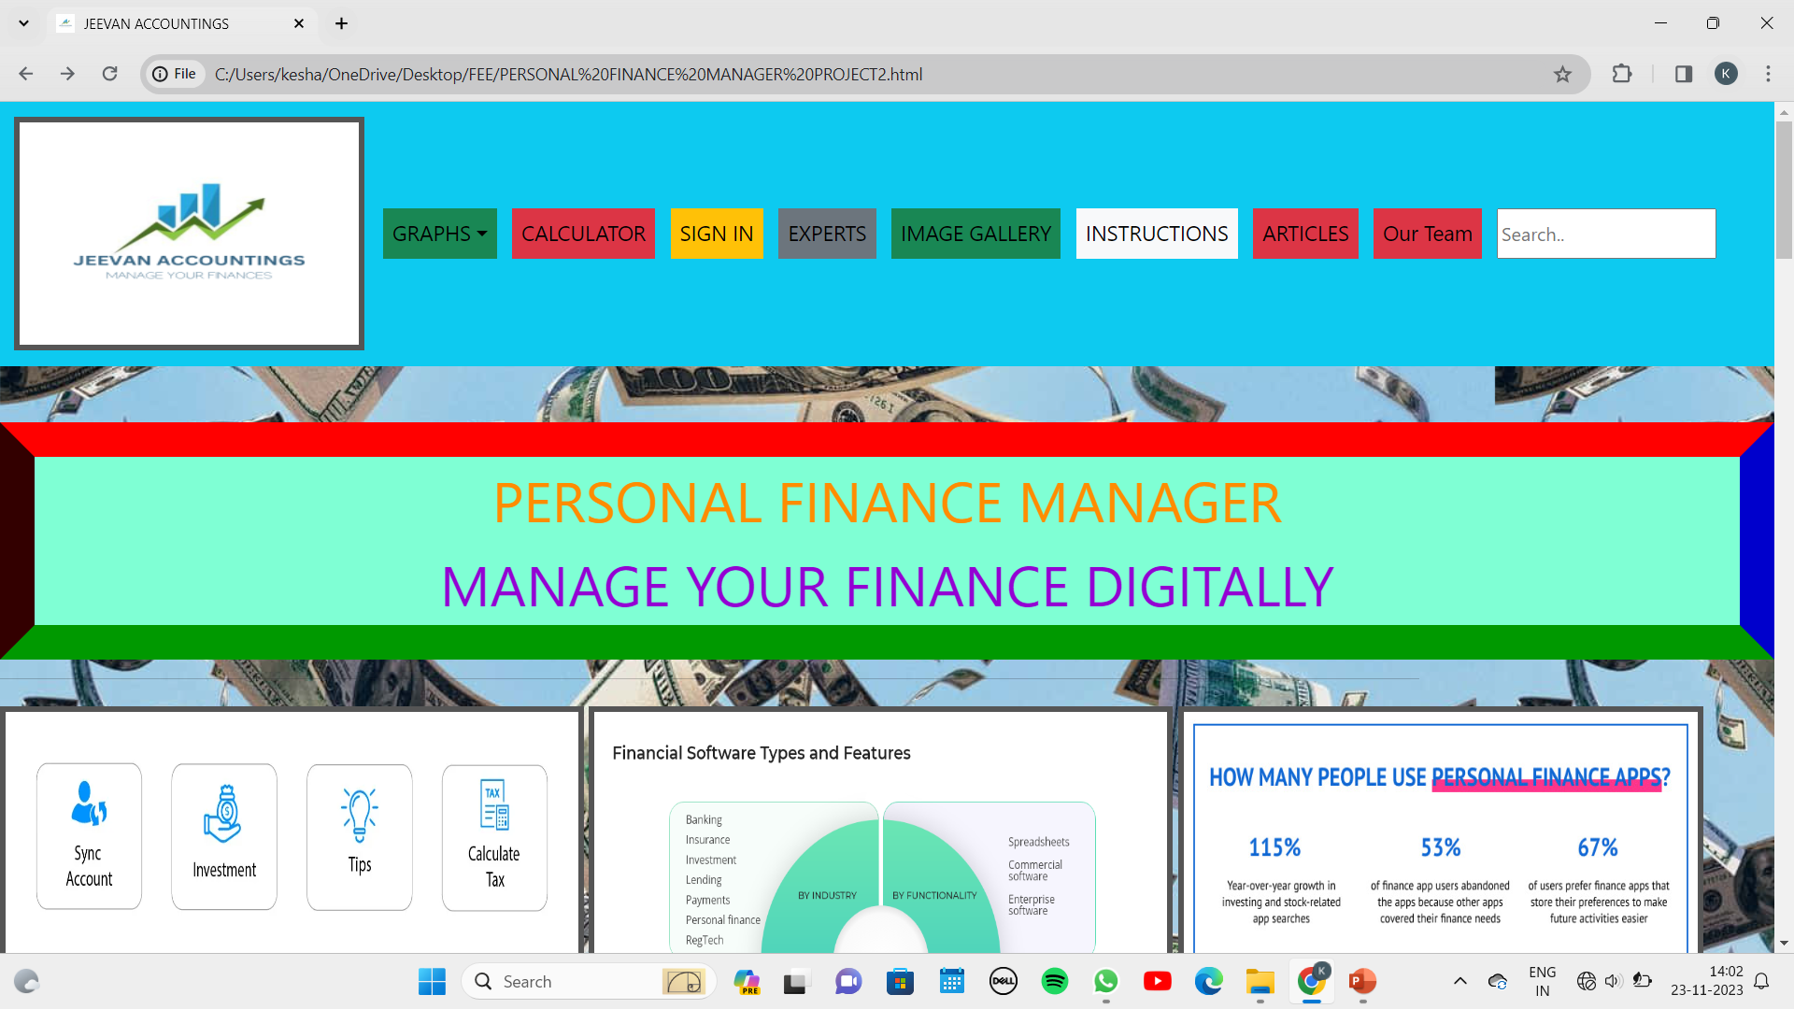
Project Highlights

Slide 10
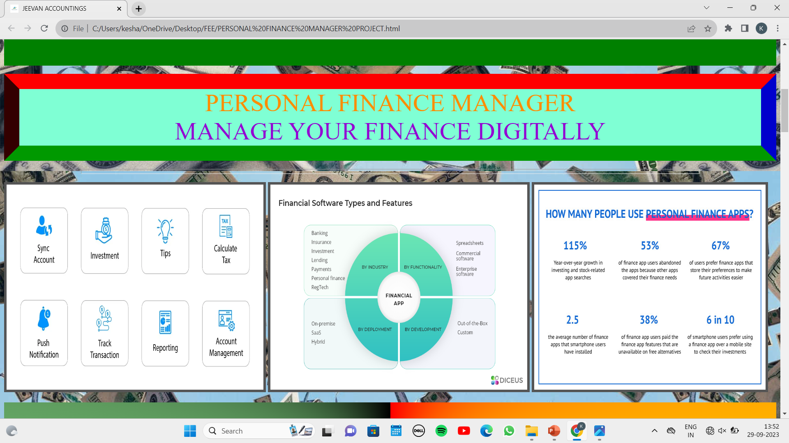

Slide 11
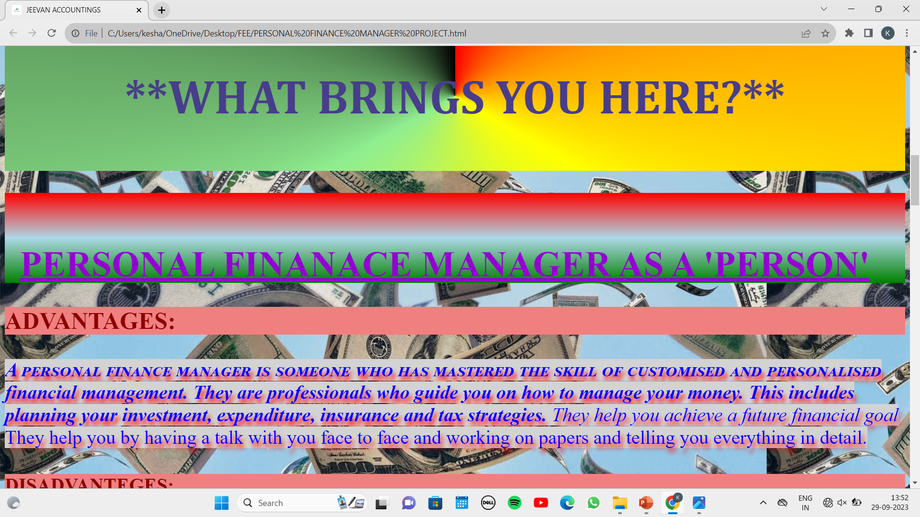

Slide 12
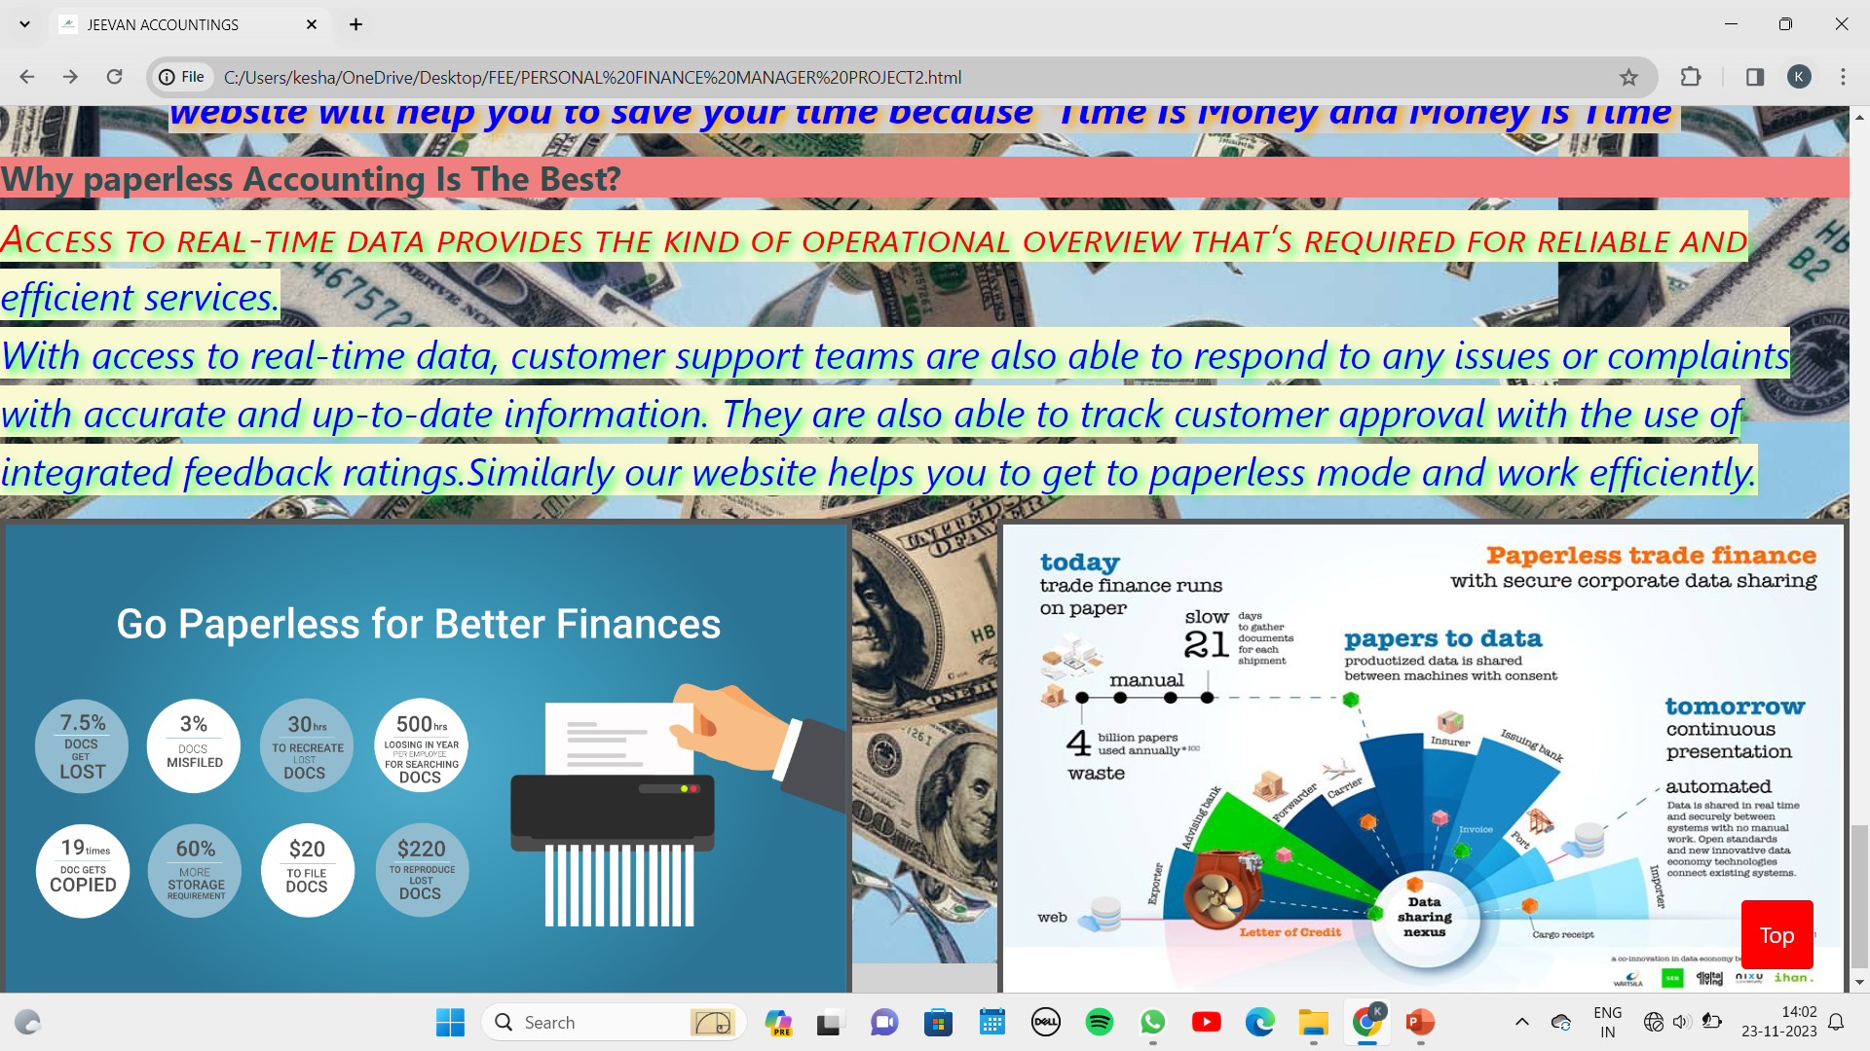

Slide 13
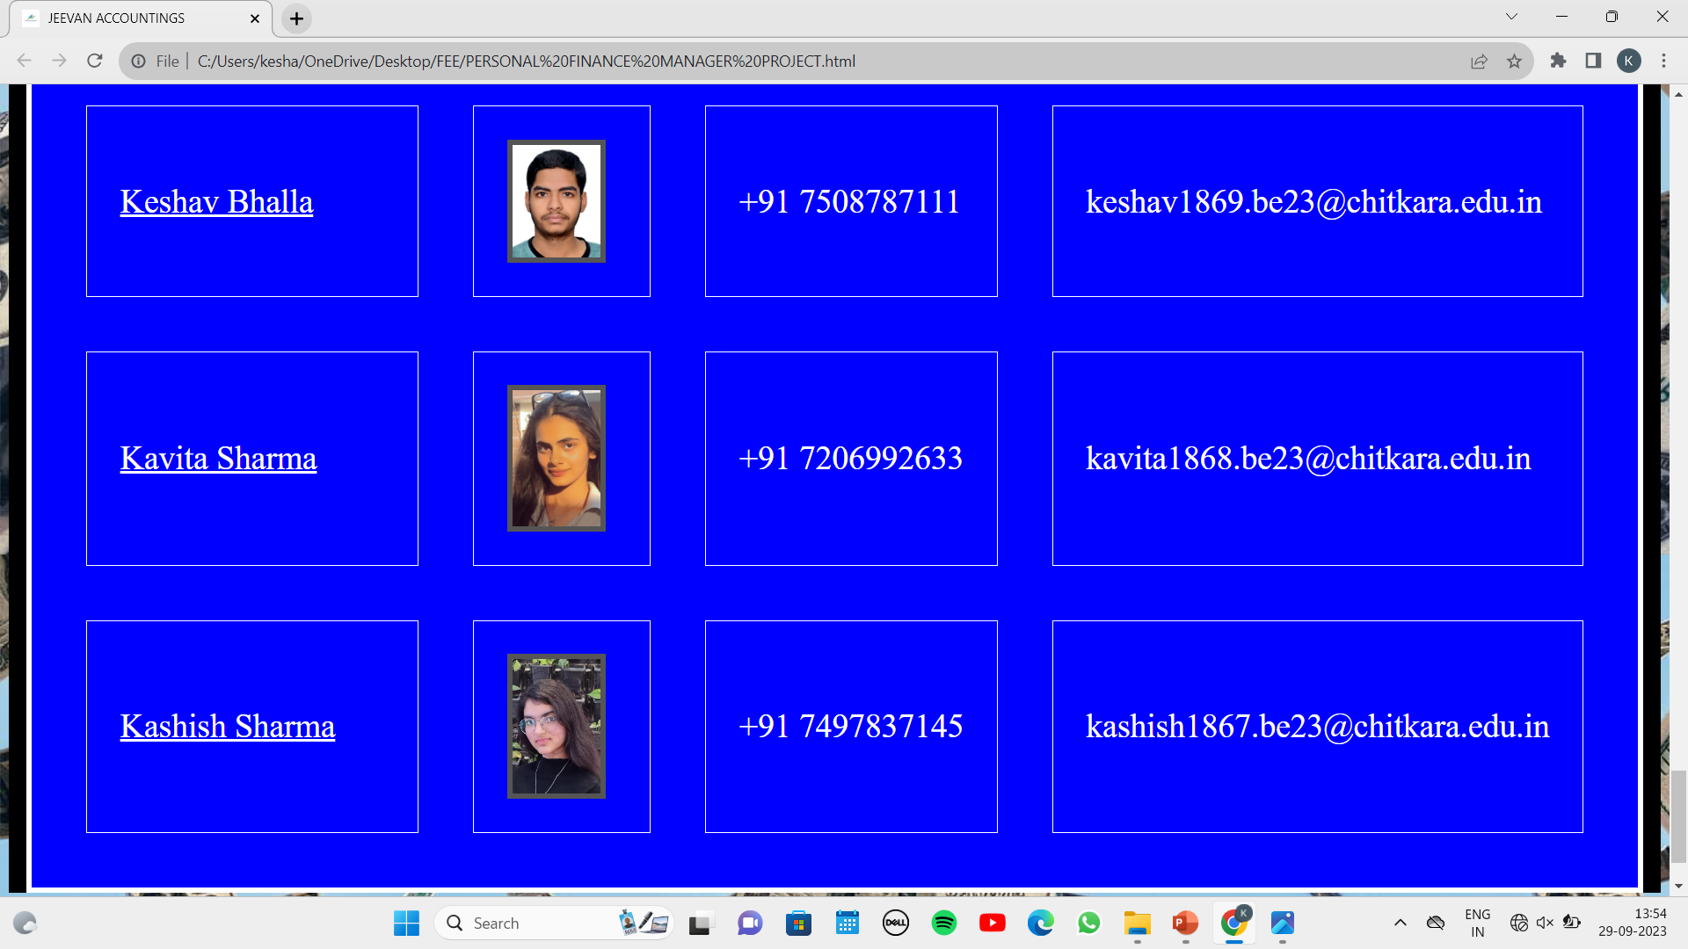

Slide 14
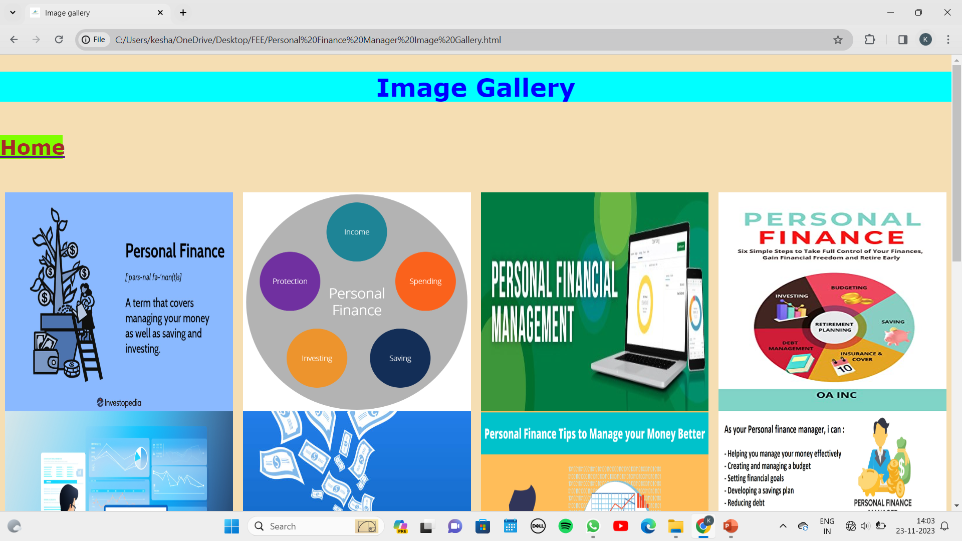

Slide 15
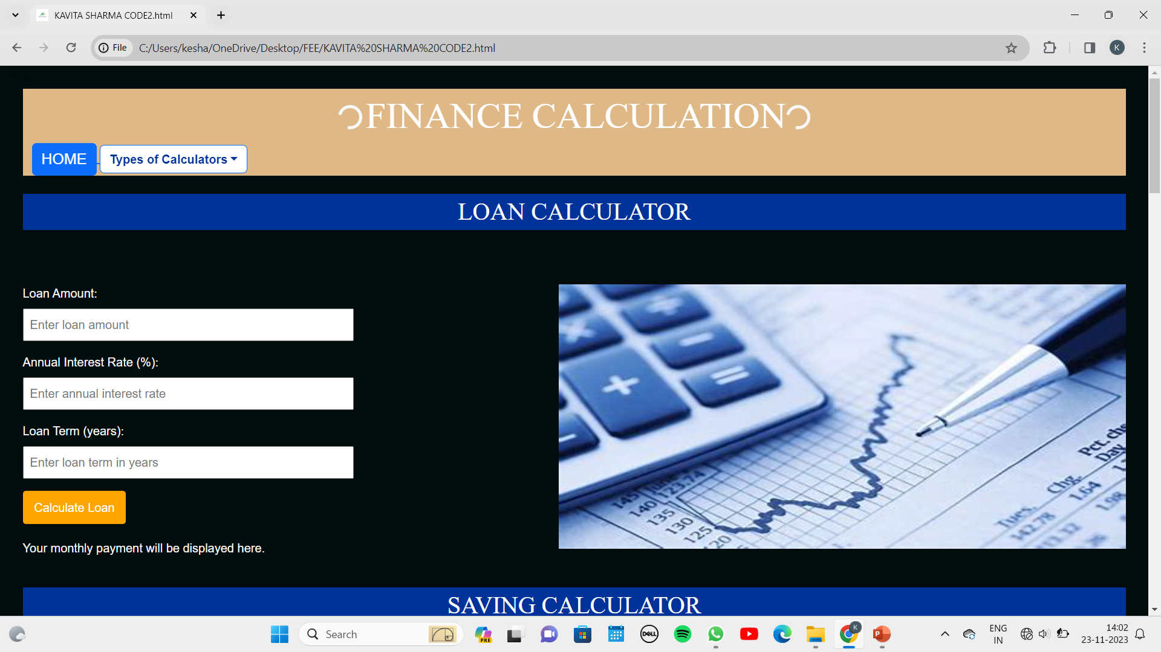

Slide 16
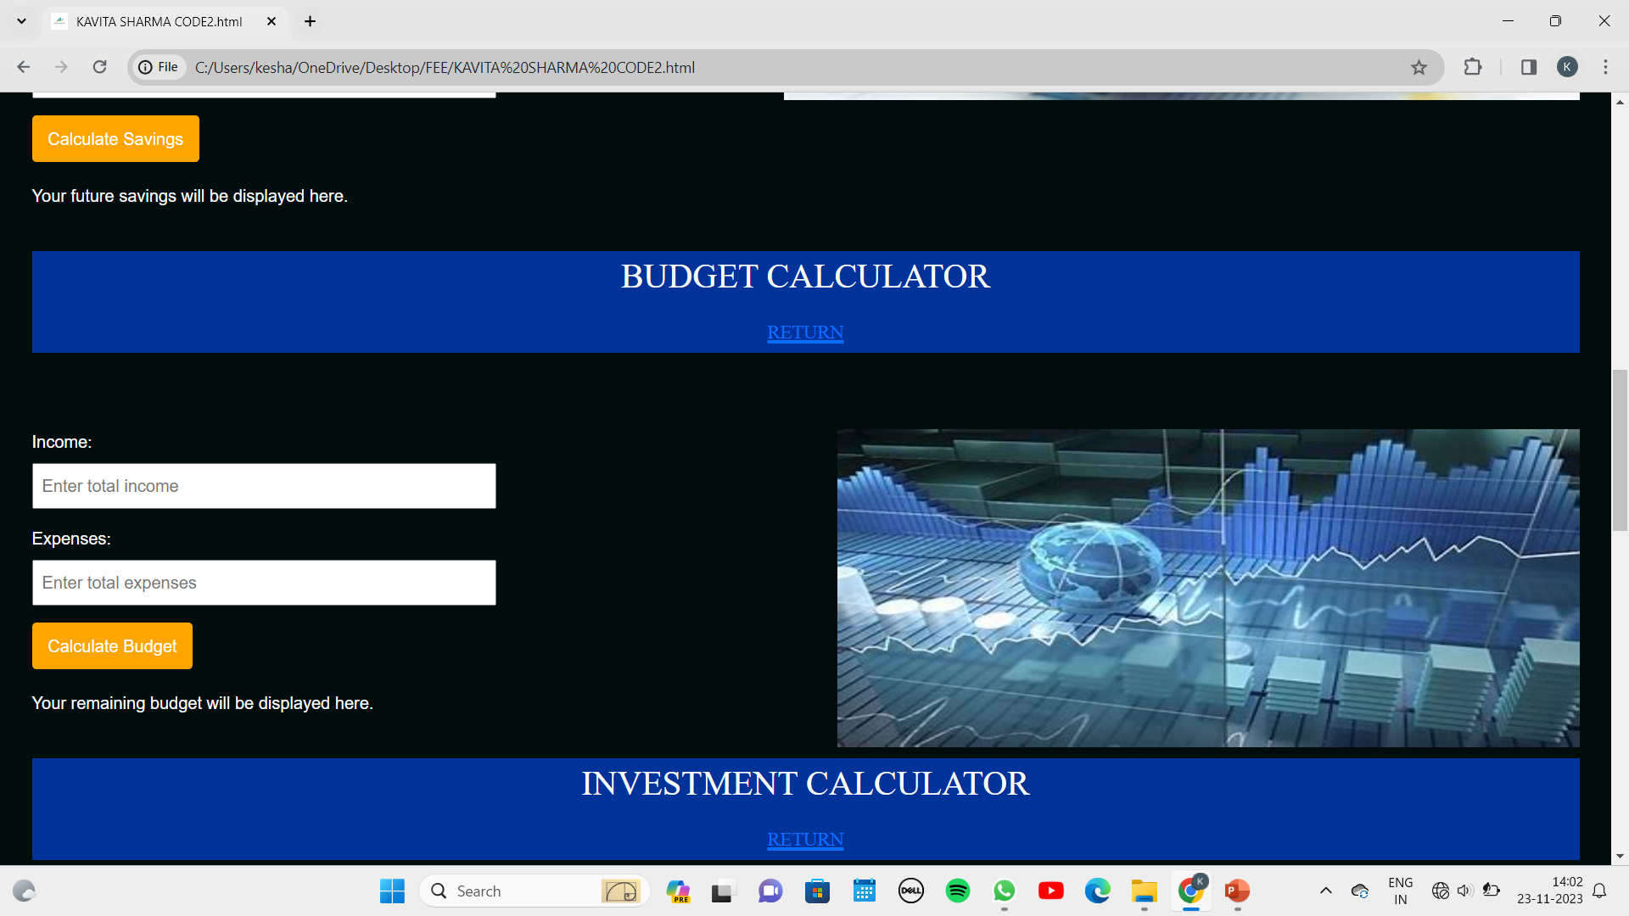

Slide 17
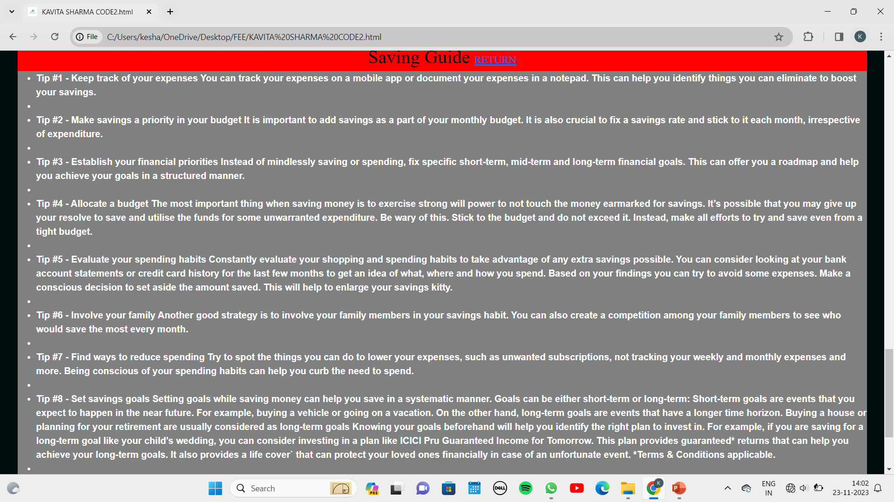

Slide 18
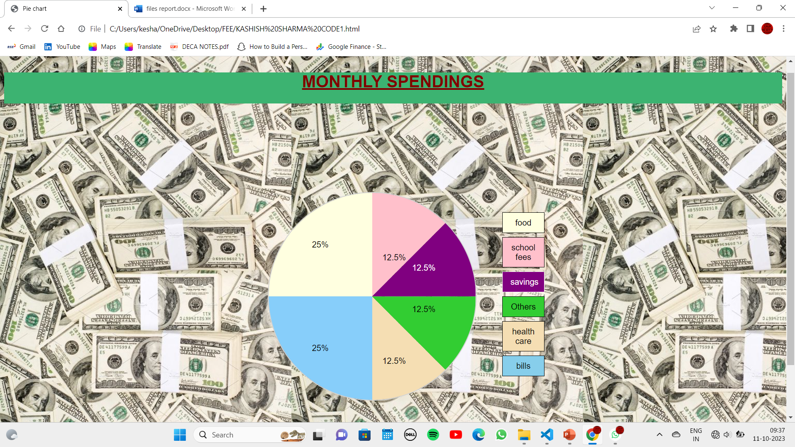

Slide 19
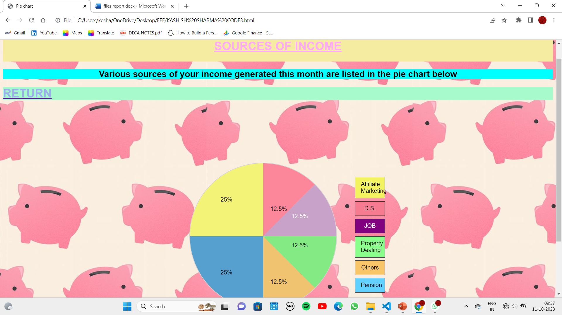

Slide 20
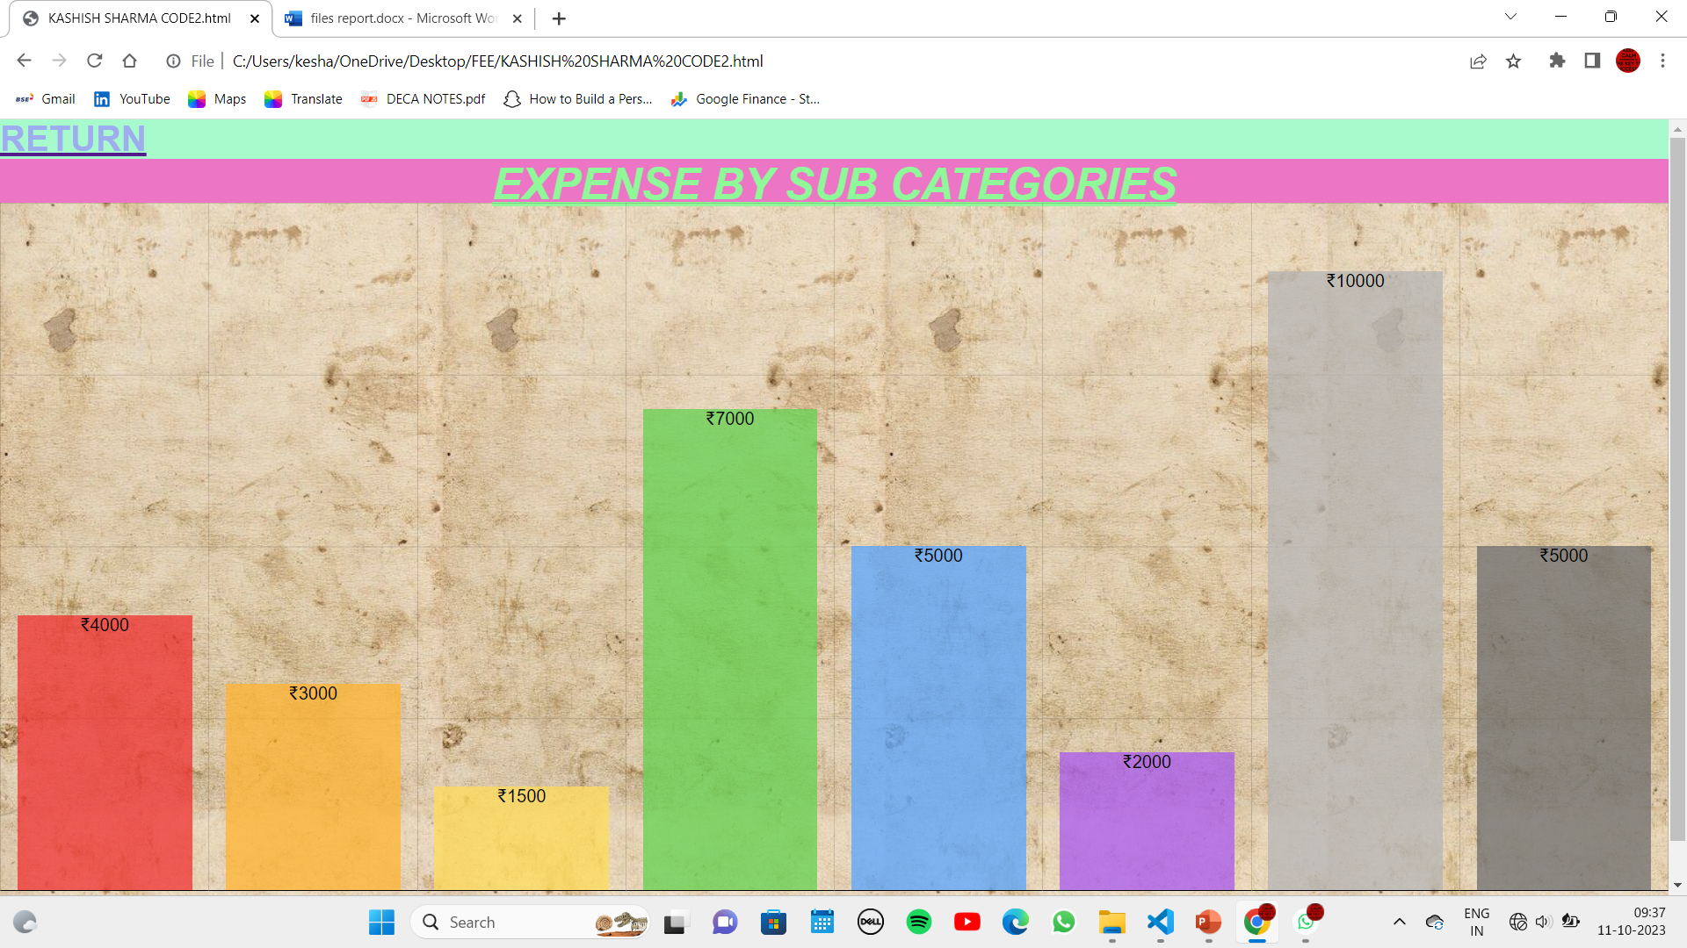

Slide 21
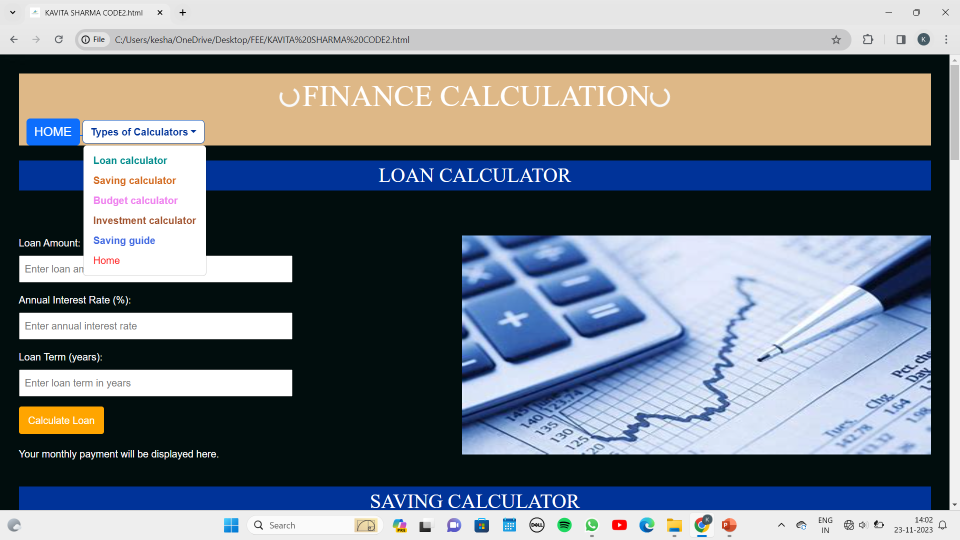

Slide 22
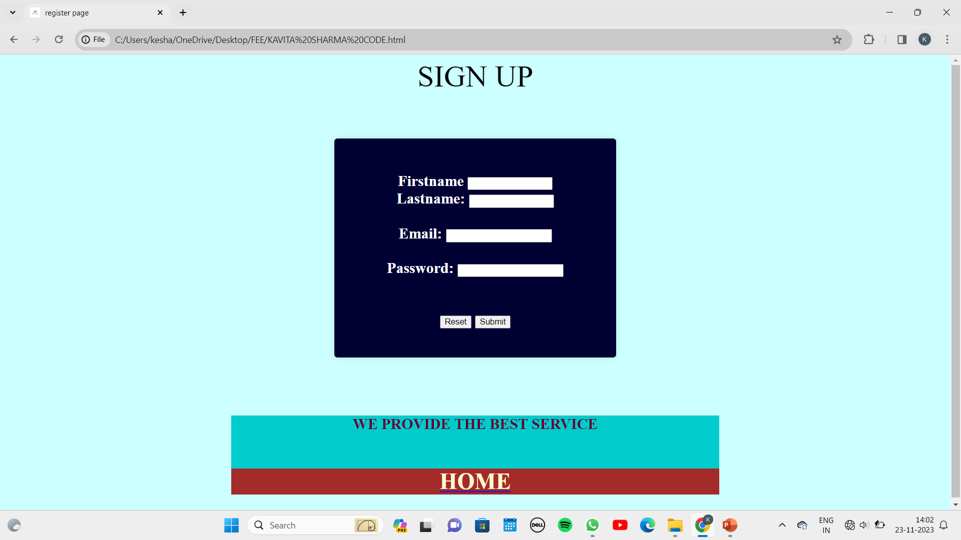

Slide 24
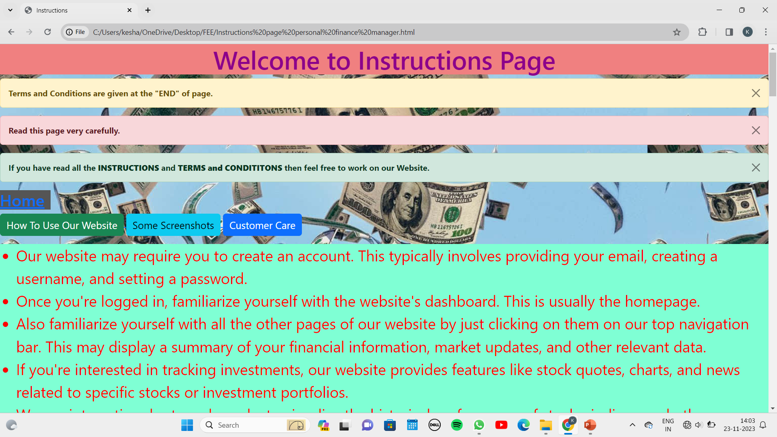

Slide 25
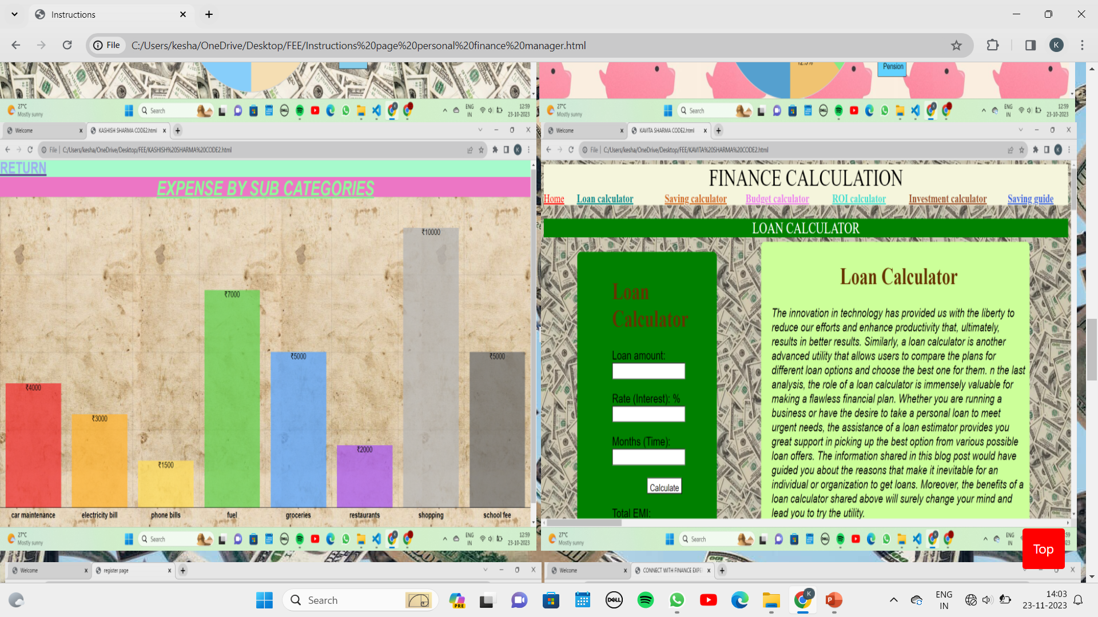

Slide 26
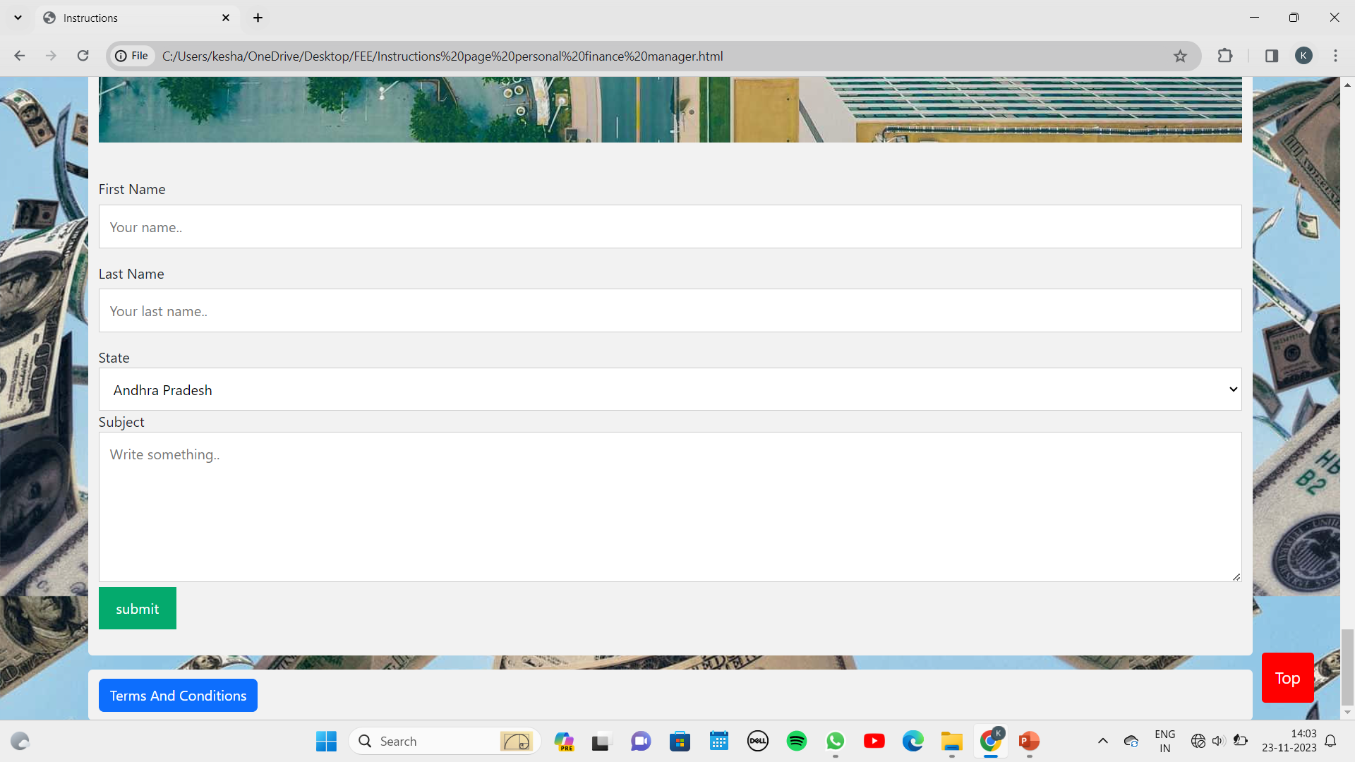

Slide 27
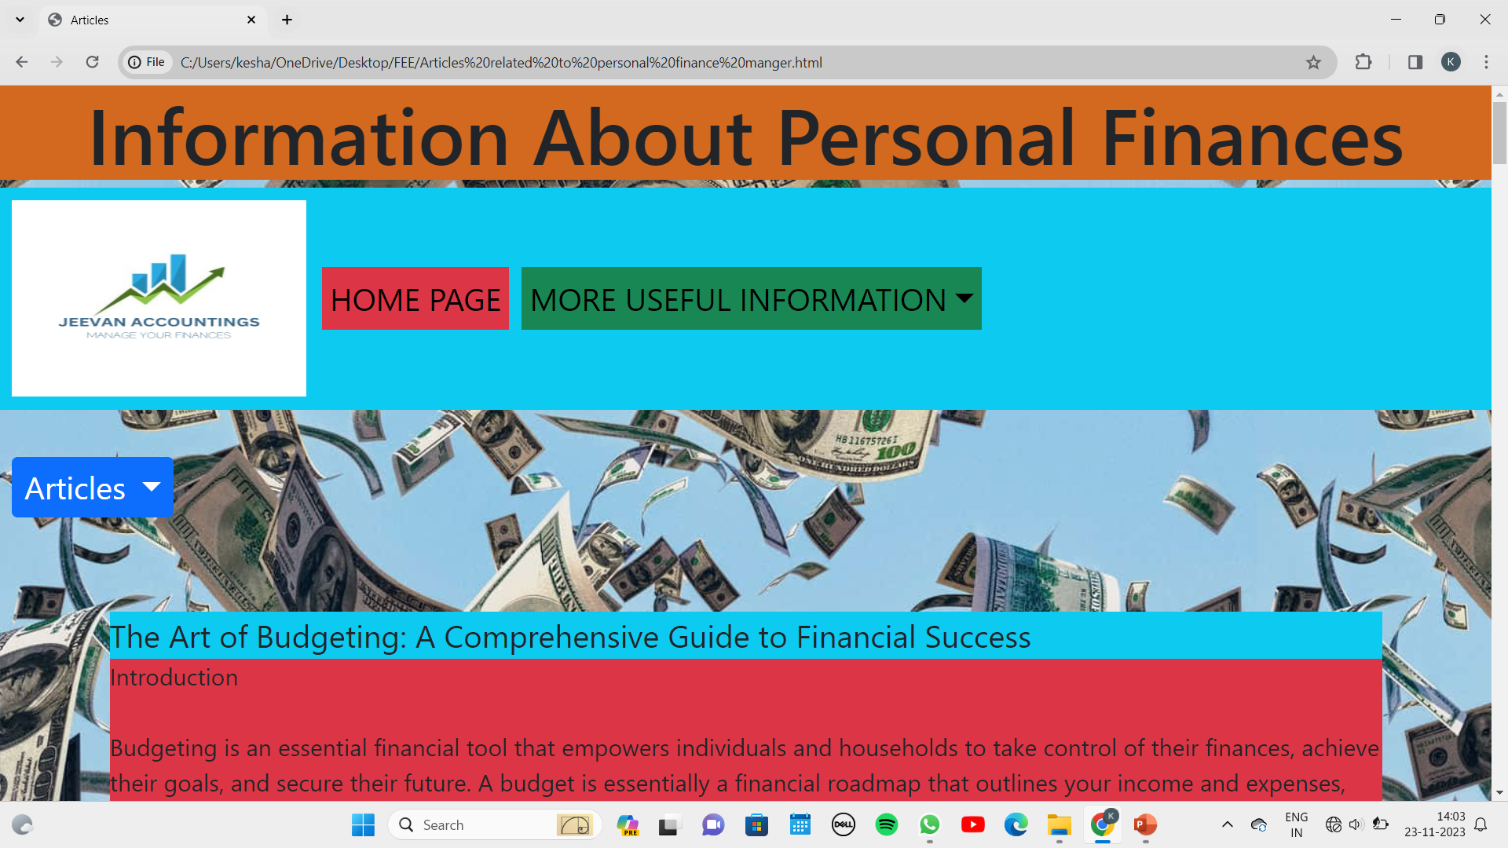

Slide 28
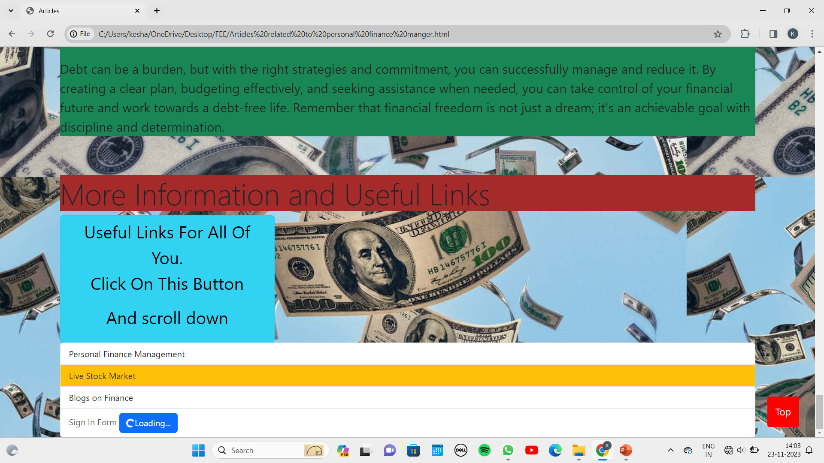

Slide 29
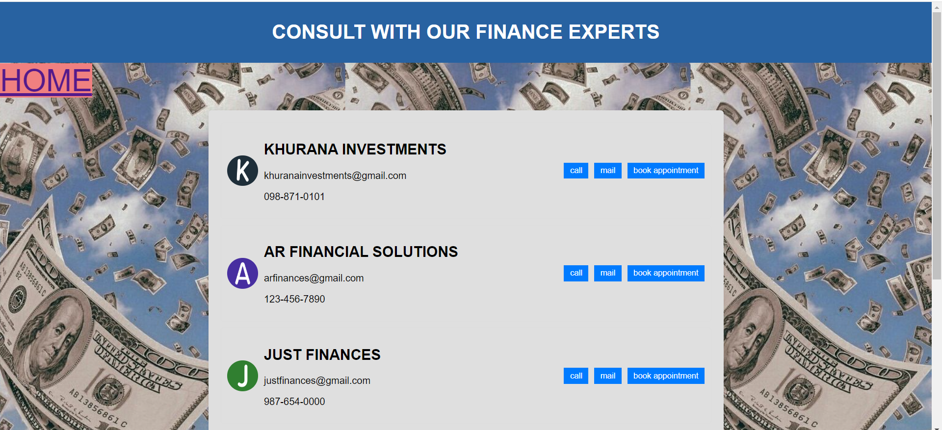
Bonus Feature(optional)
A Bonus feature added is that we have provided our users with some of our experts and their details , so that users can have a professional talk on a serious topic like money and their financial status .

Slide 30
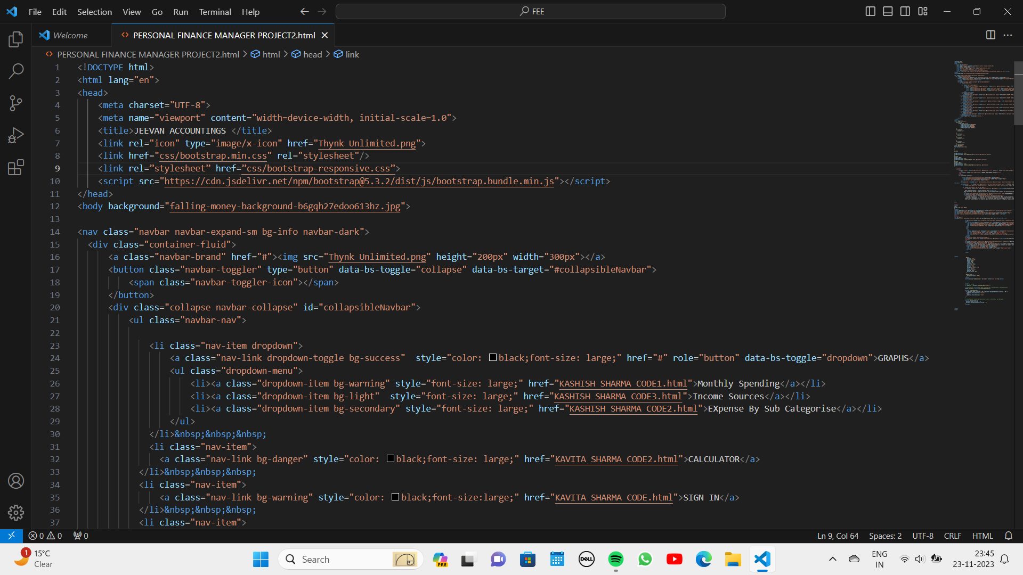

Slide 31
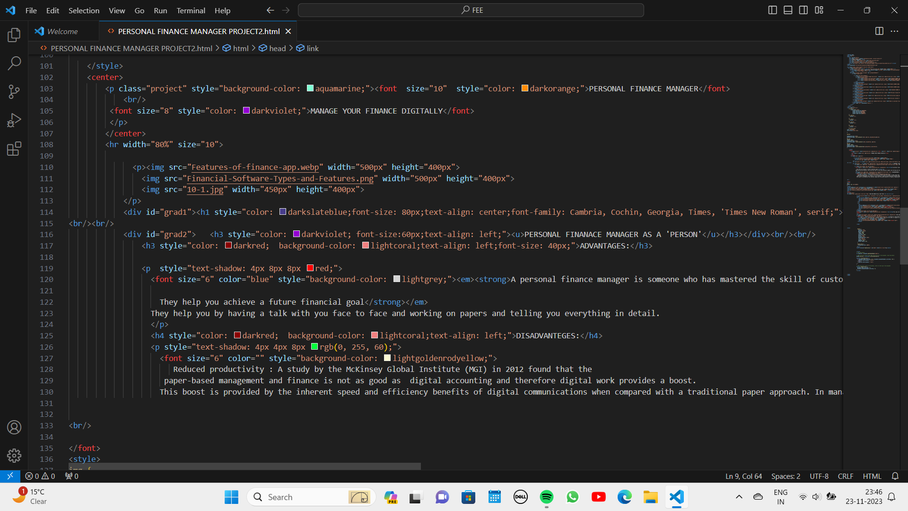

Slide 32
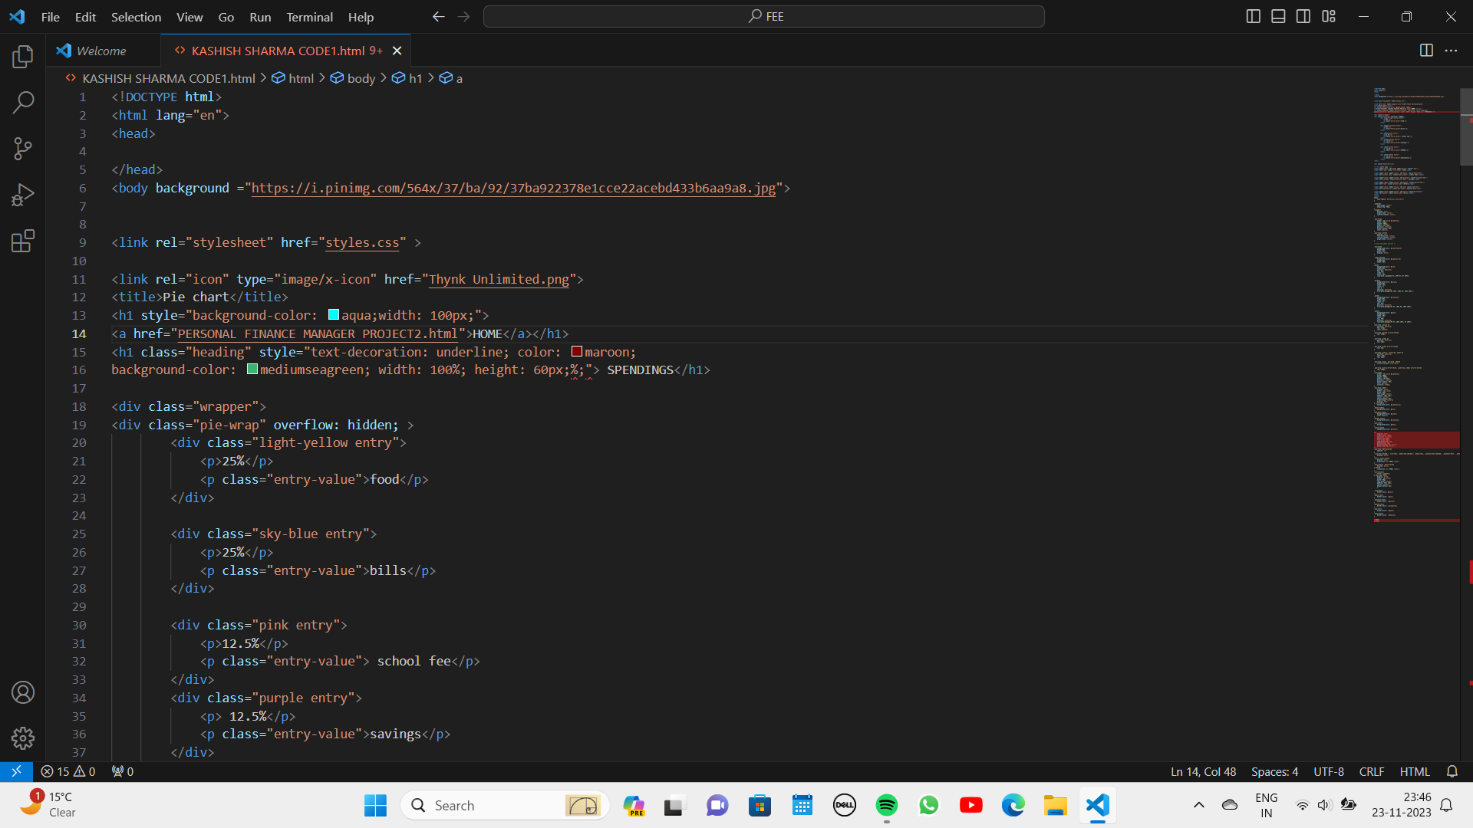

Slide 33
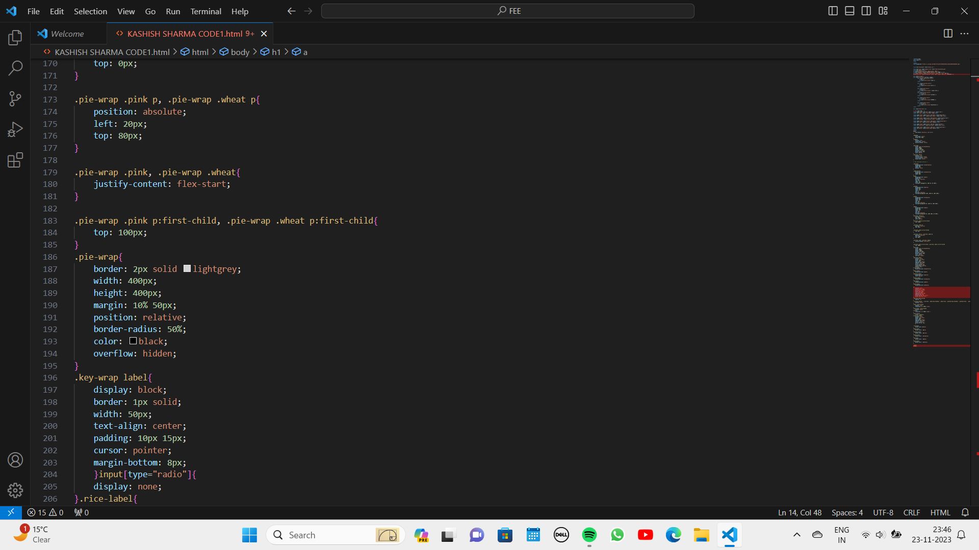

Slide 34
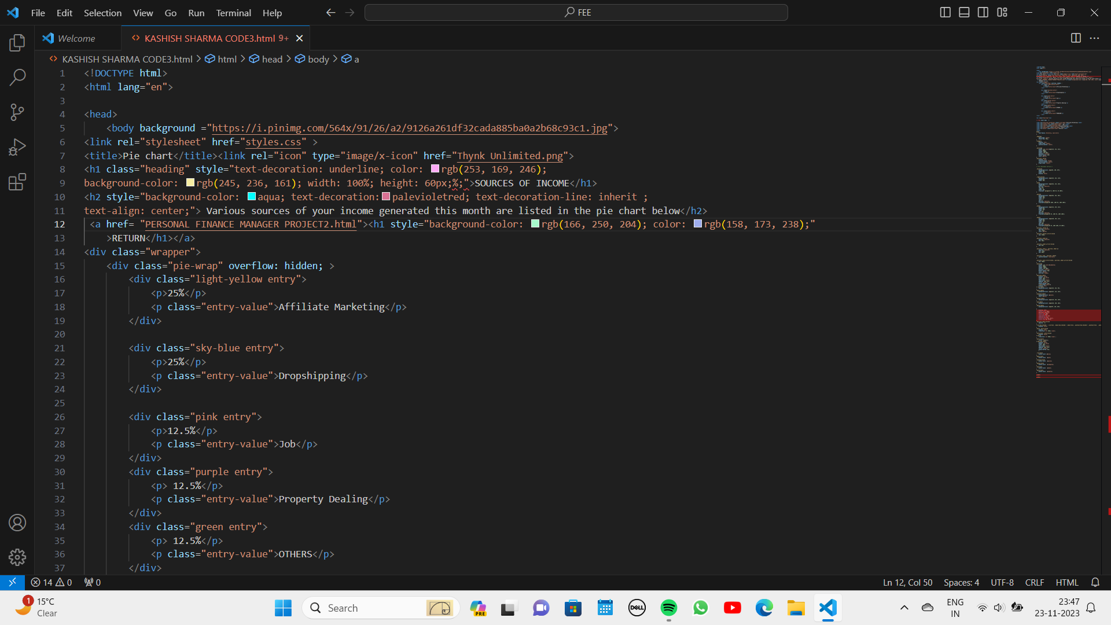

Slide 35
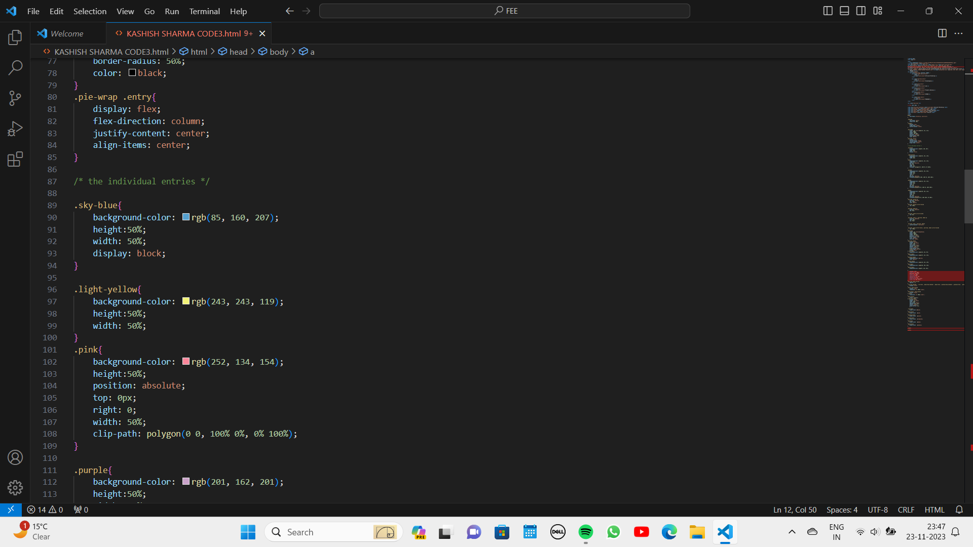

Slide 36
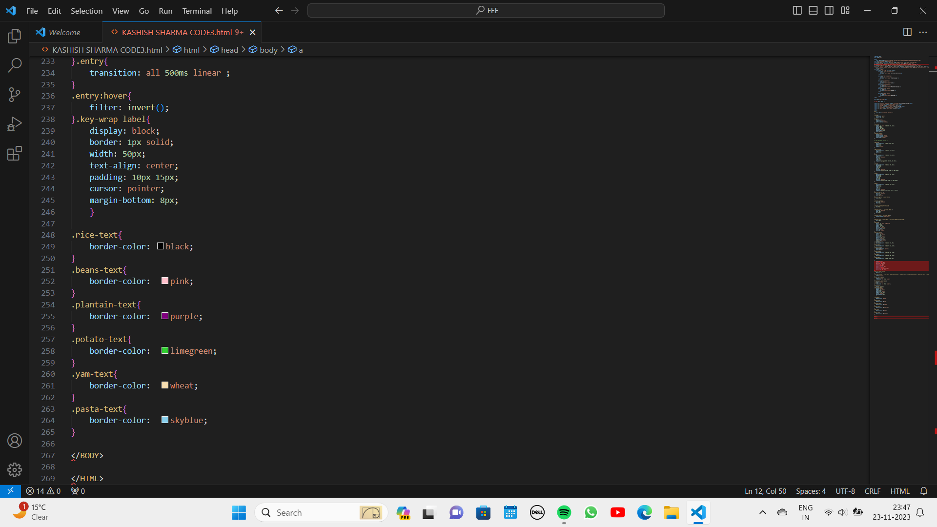

Slide 37
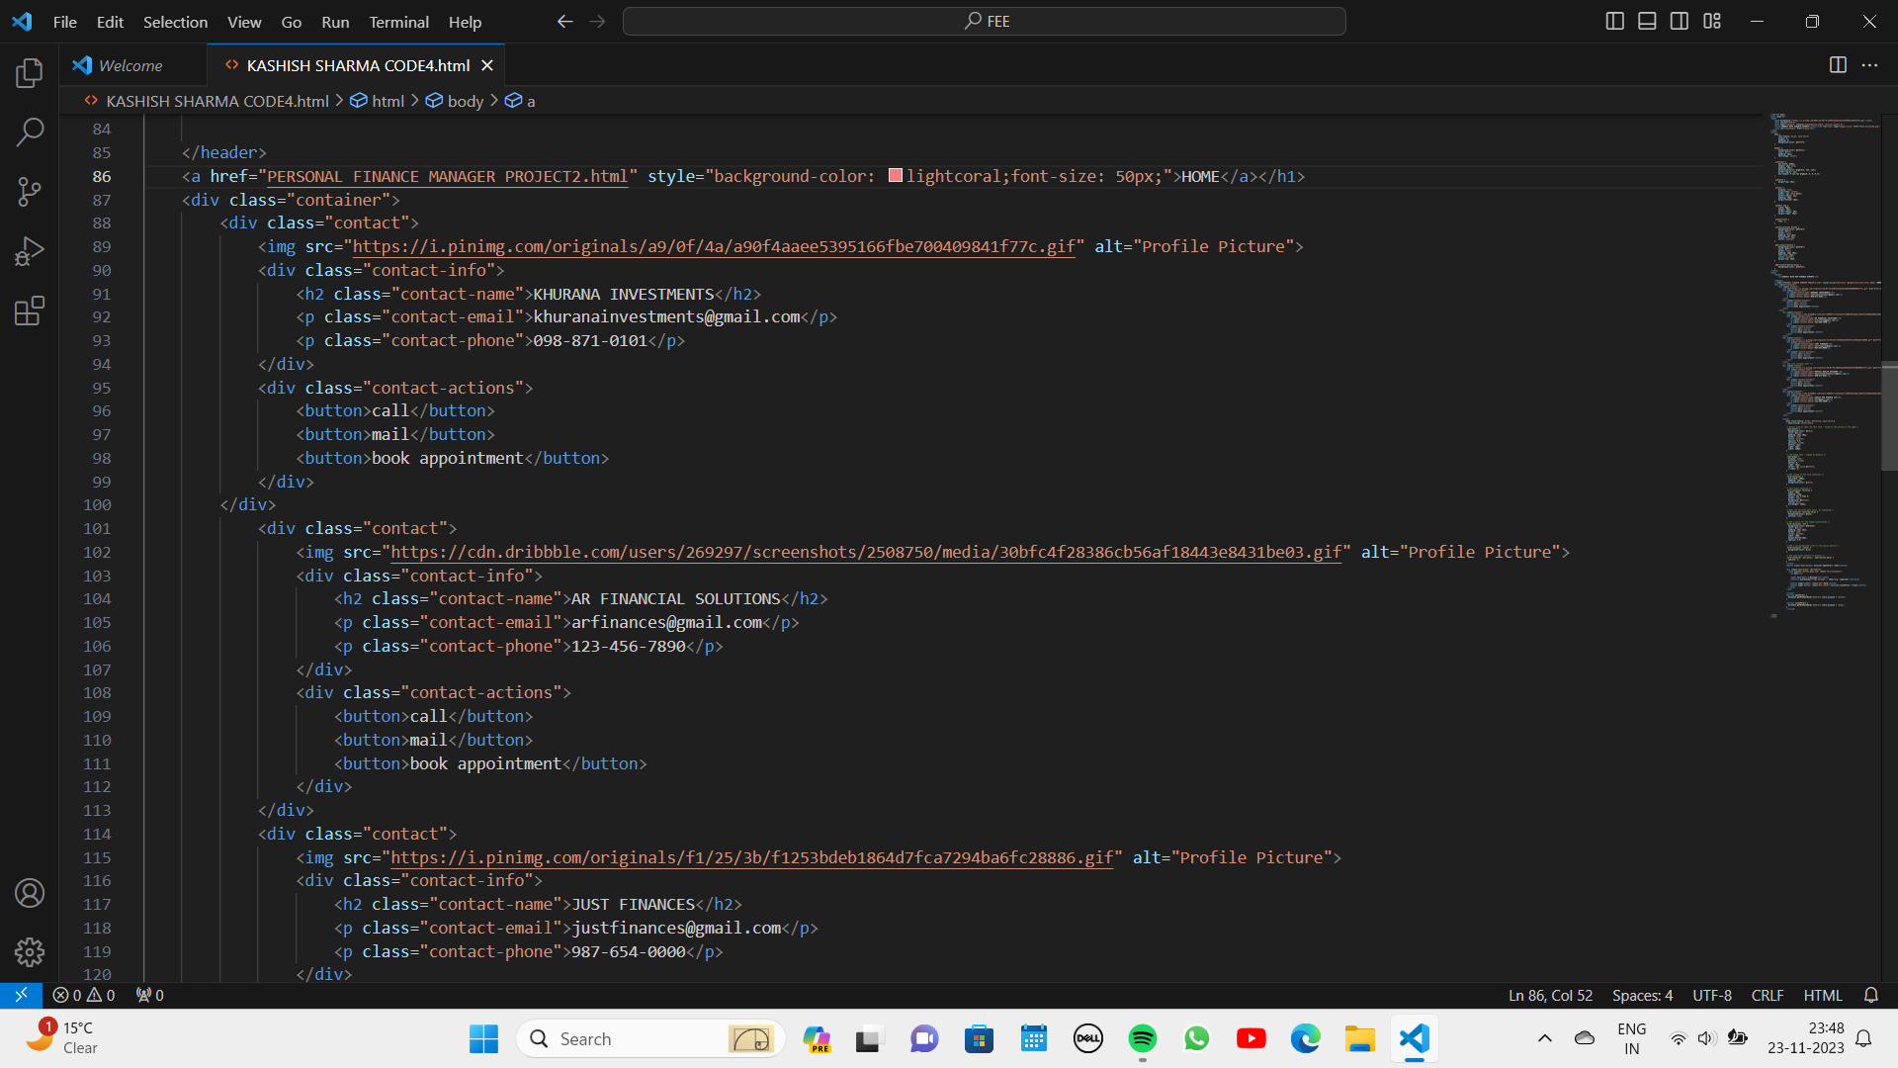

Slide 38
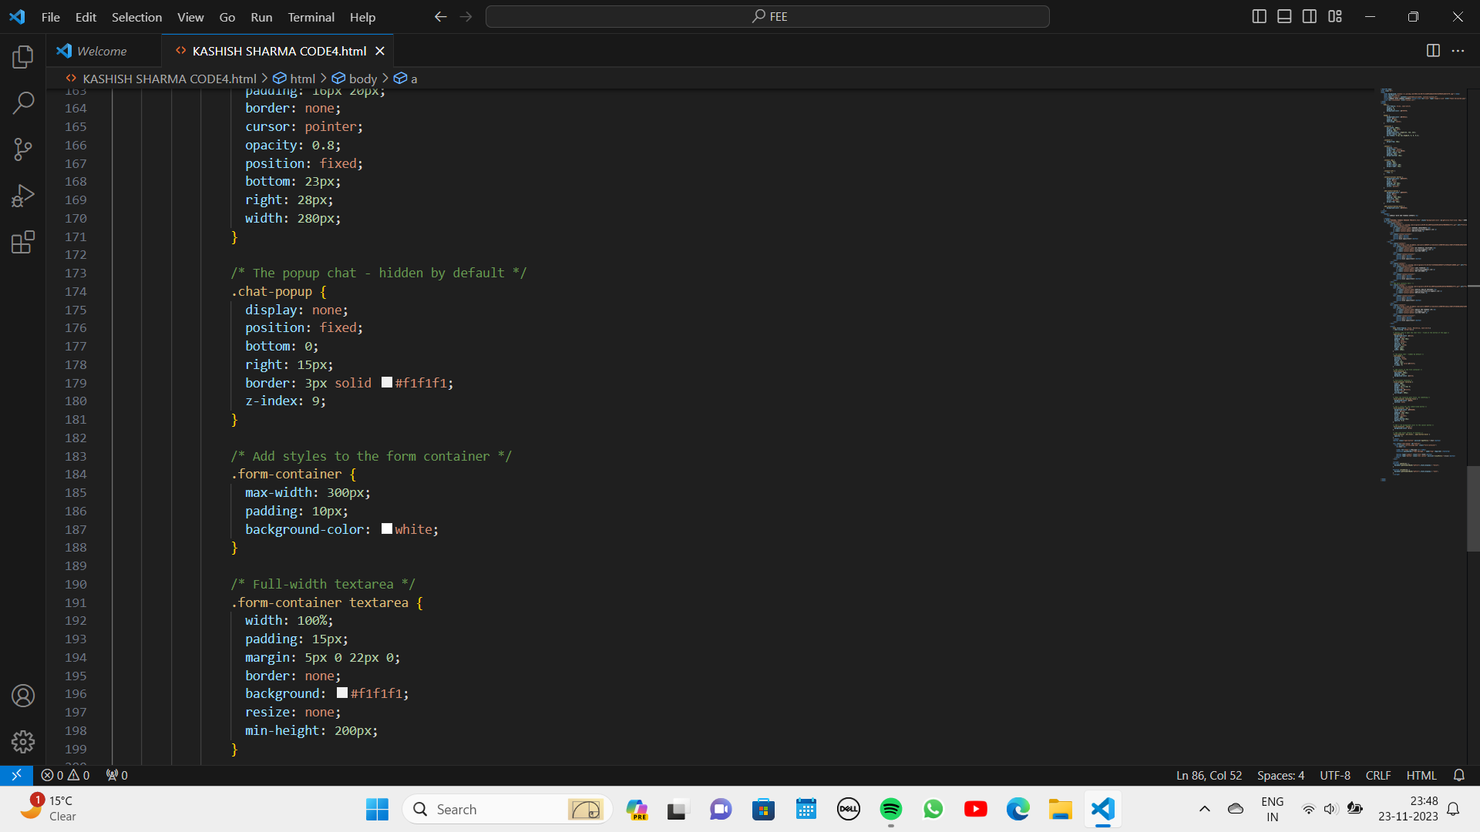

Slide 39
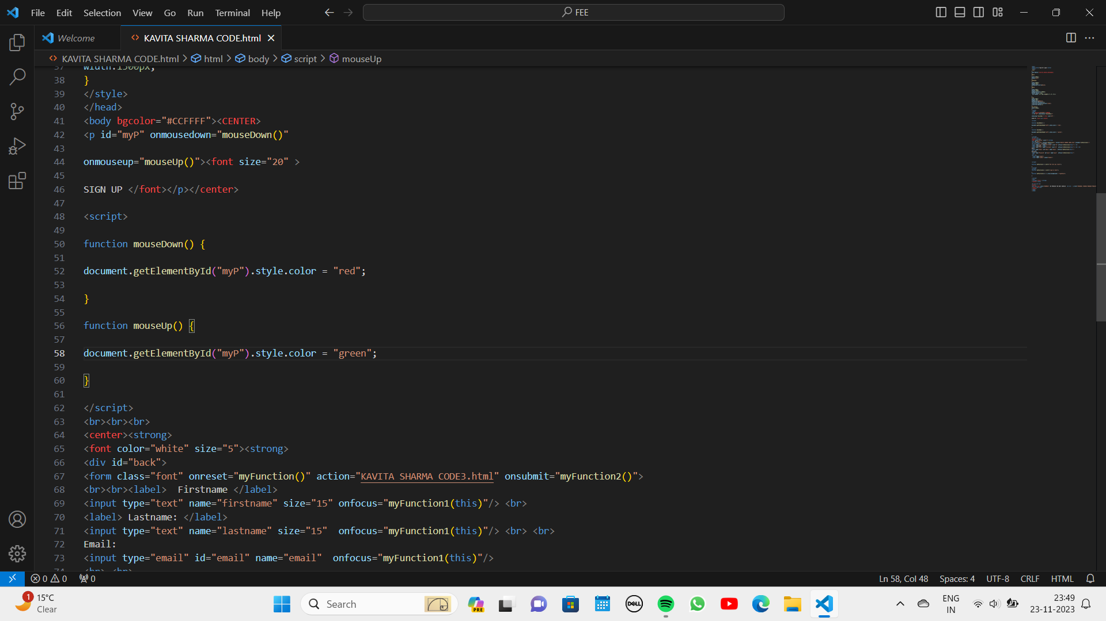

Slide 40
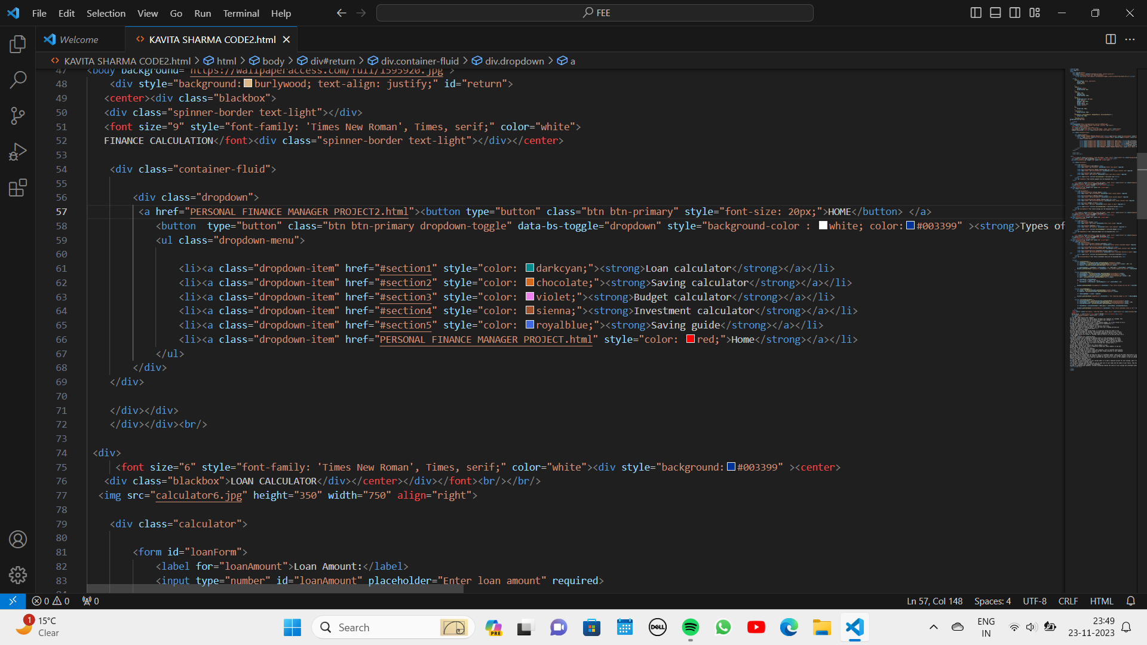

Slide 41
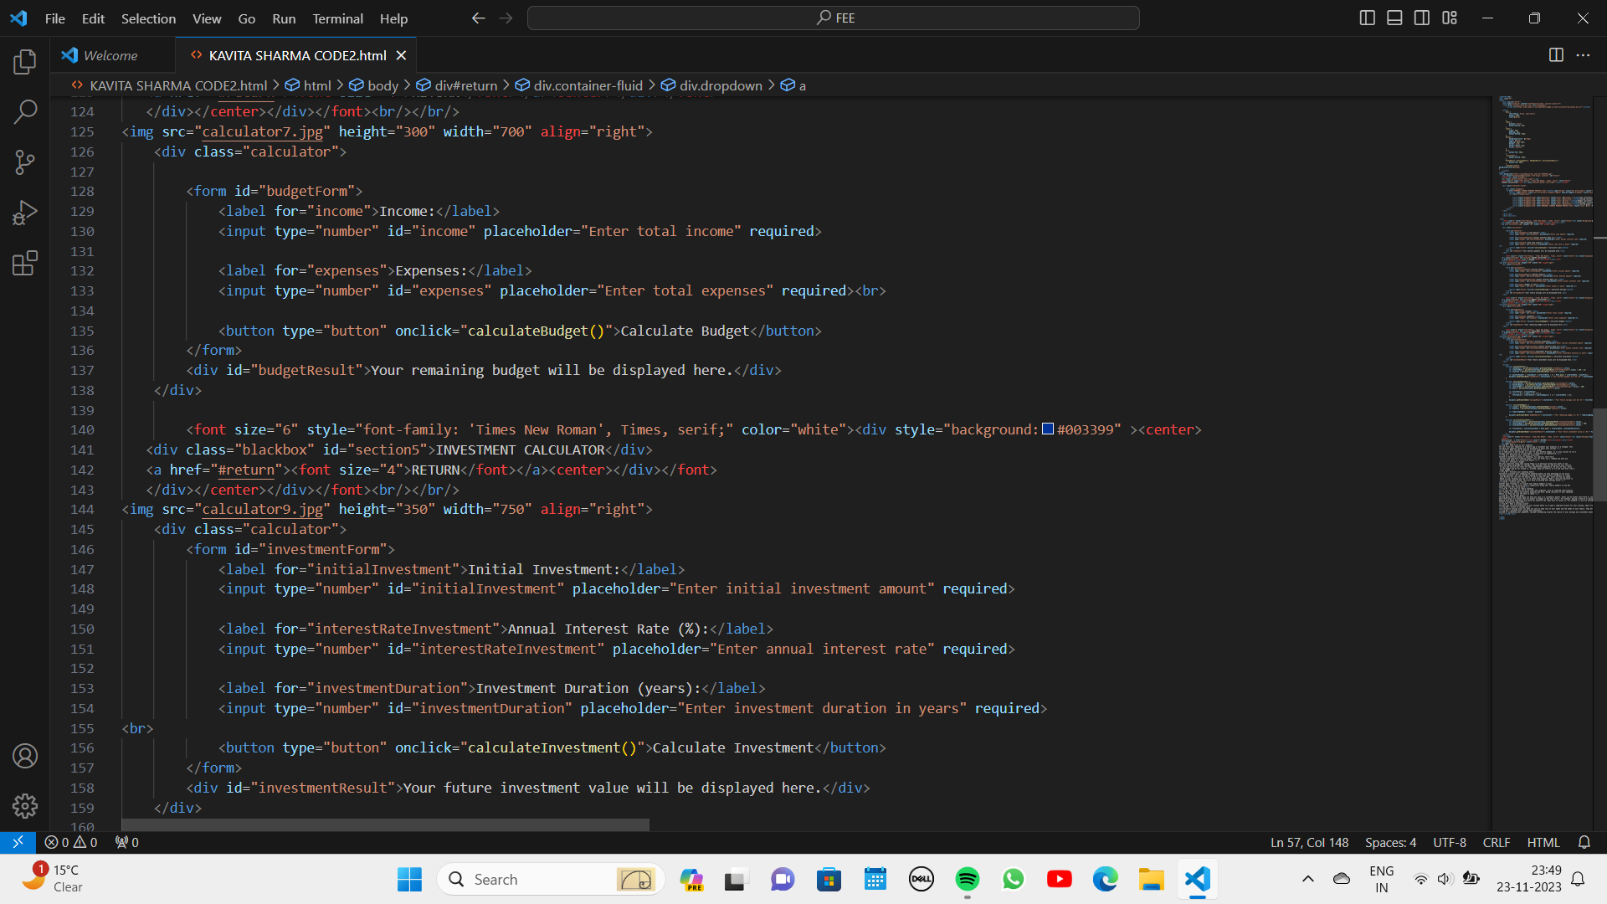

Slide 42
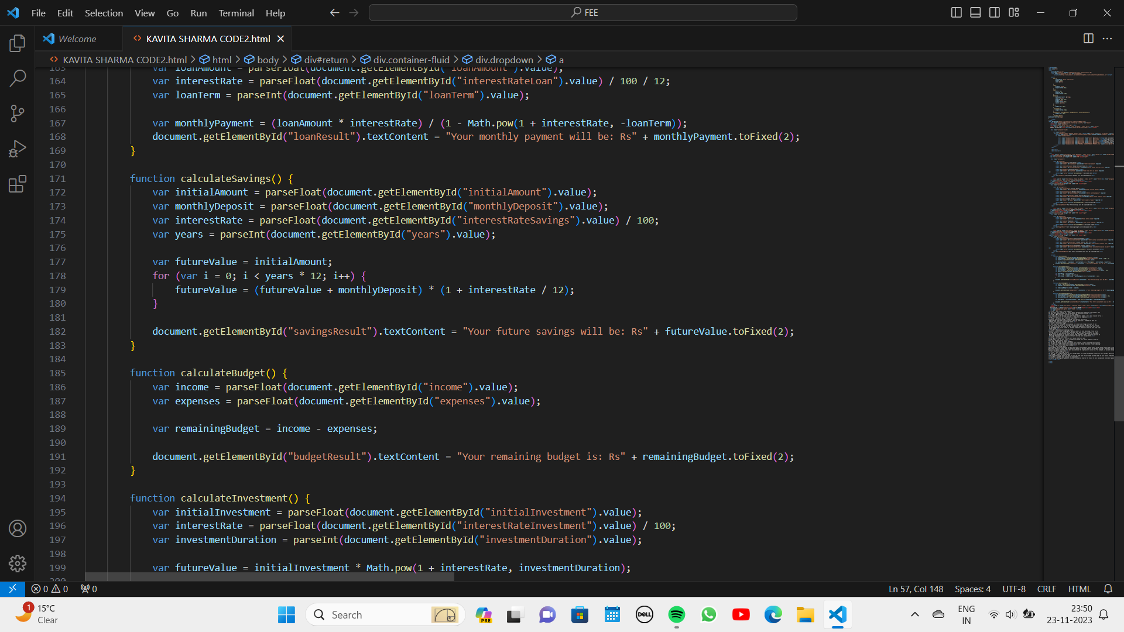

Slide 43
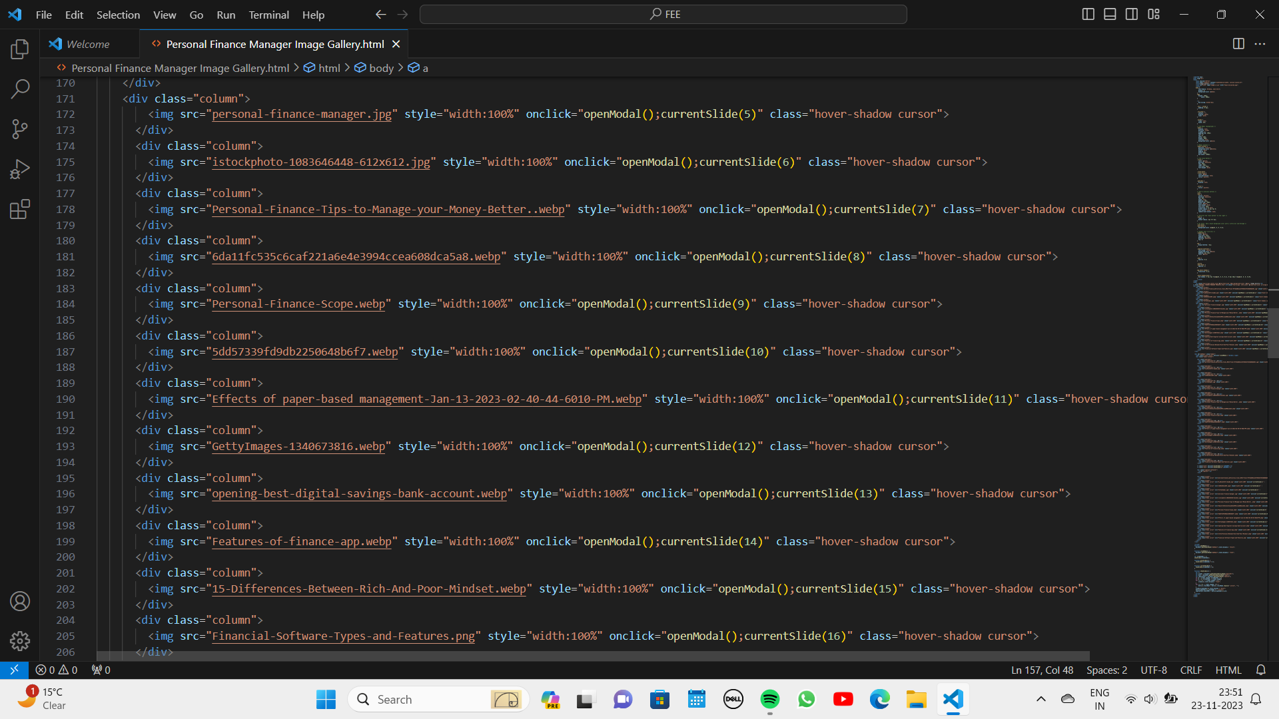

Slide 44
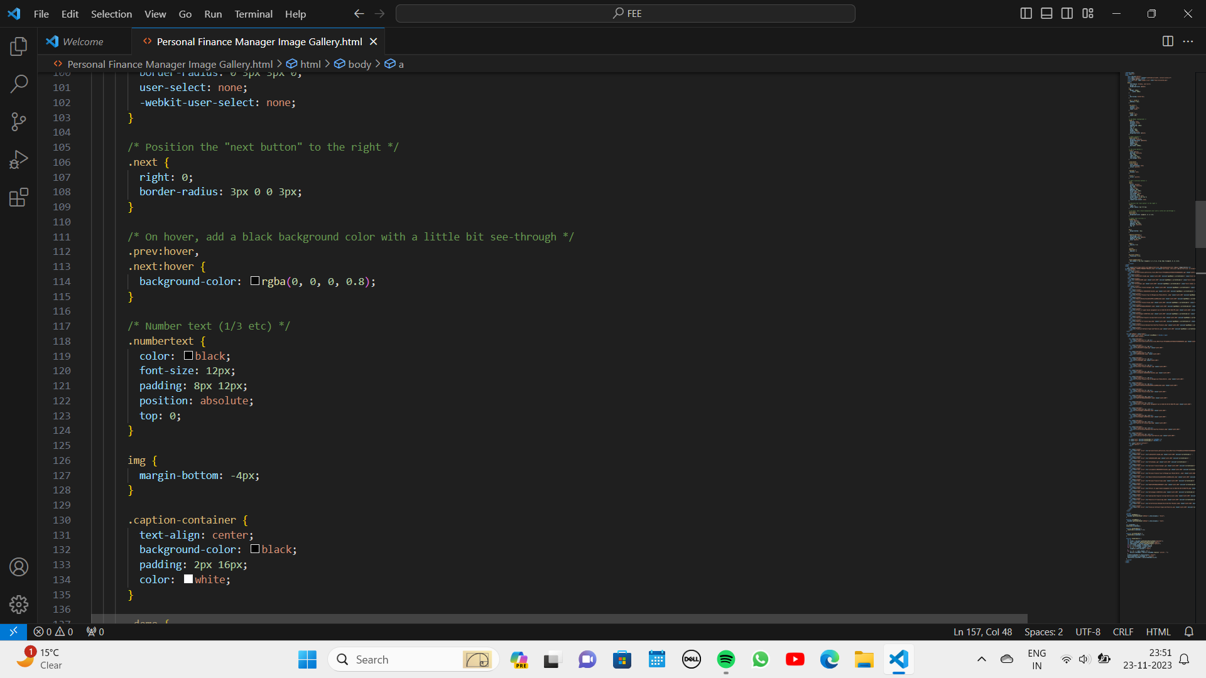

Slide 45
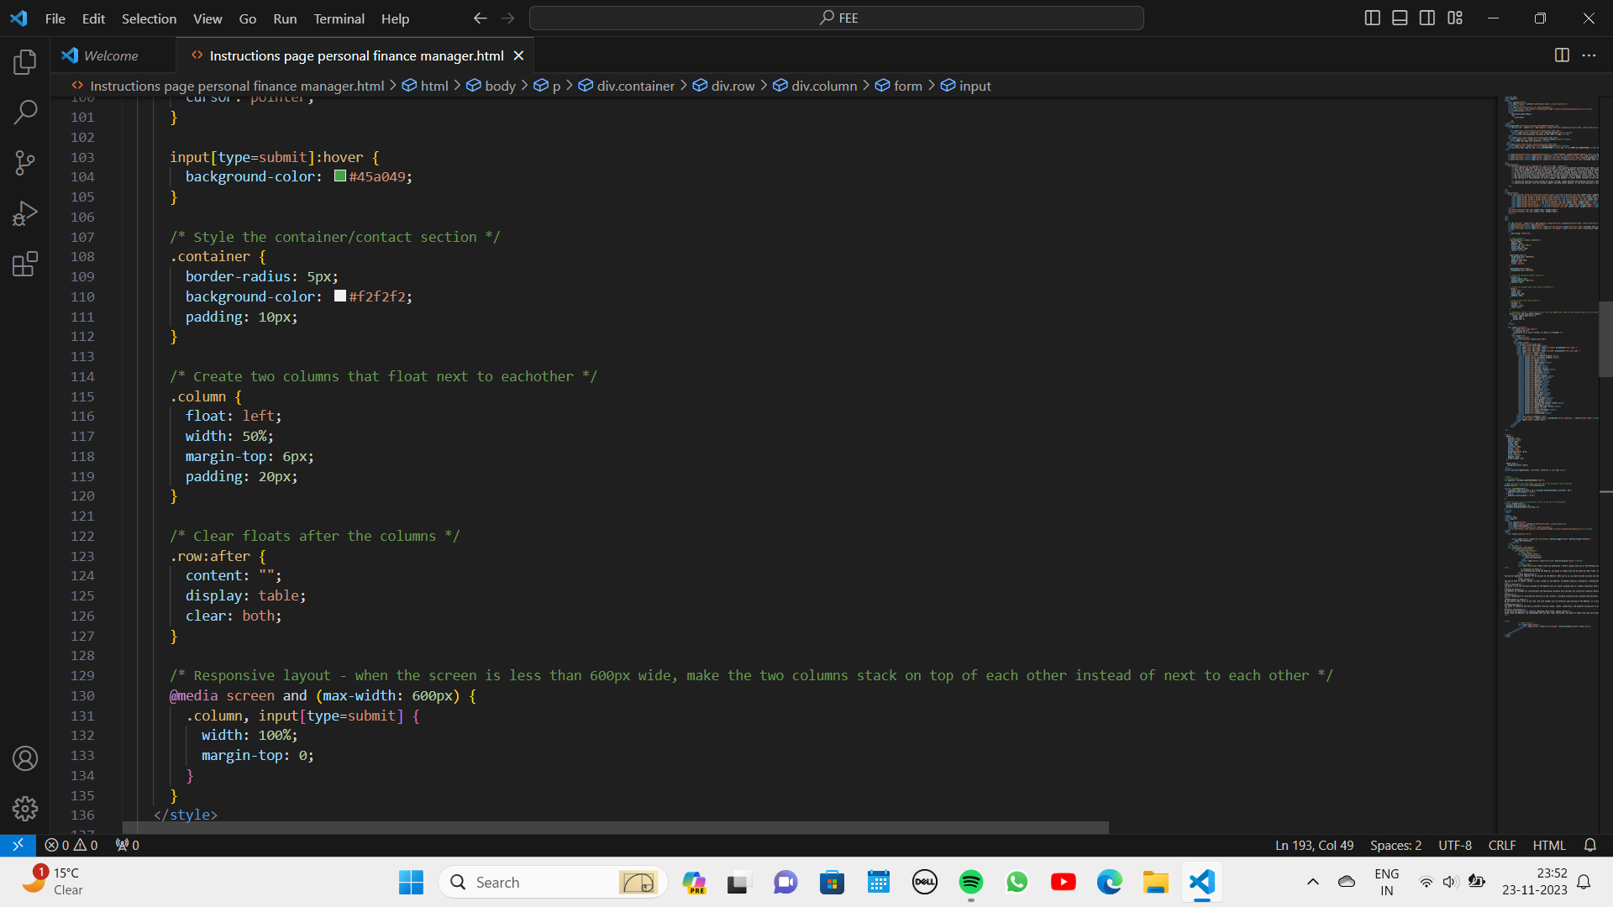
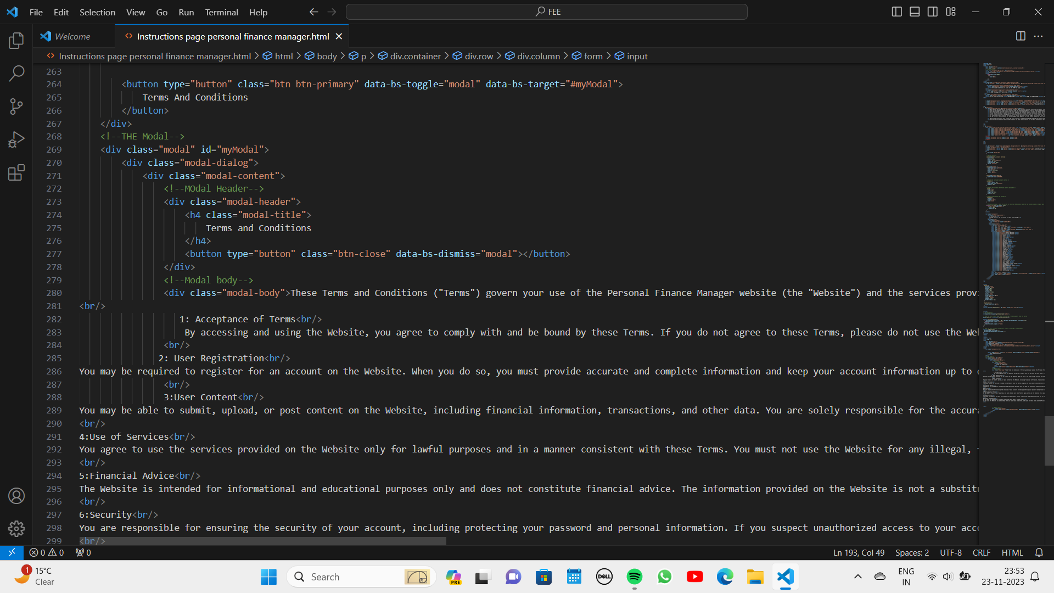

Slide 46
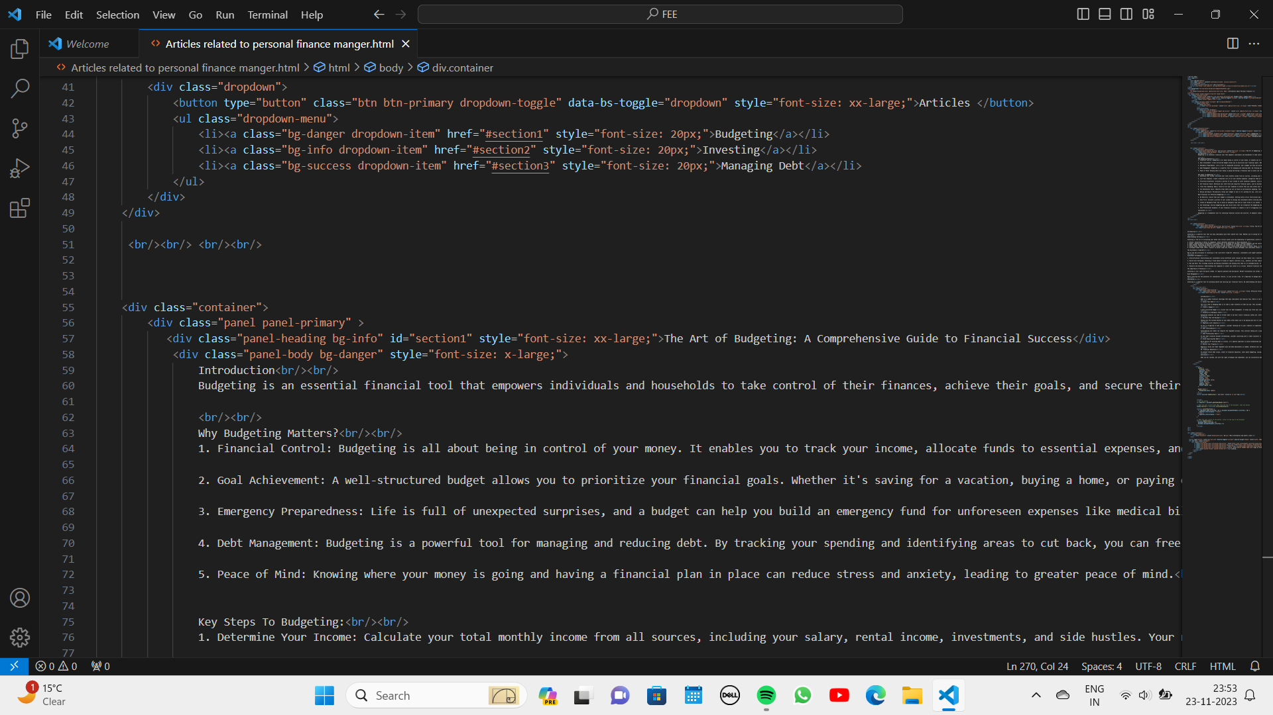

Slide 47
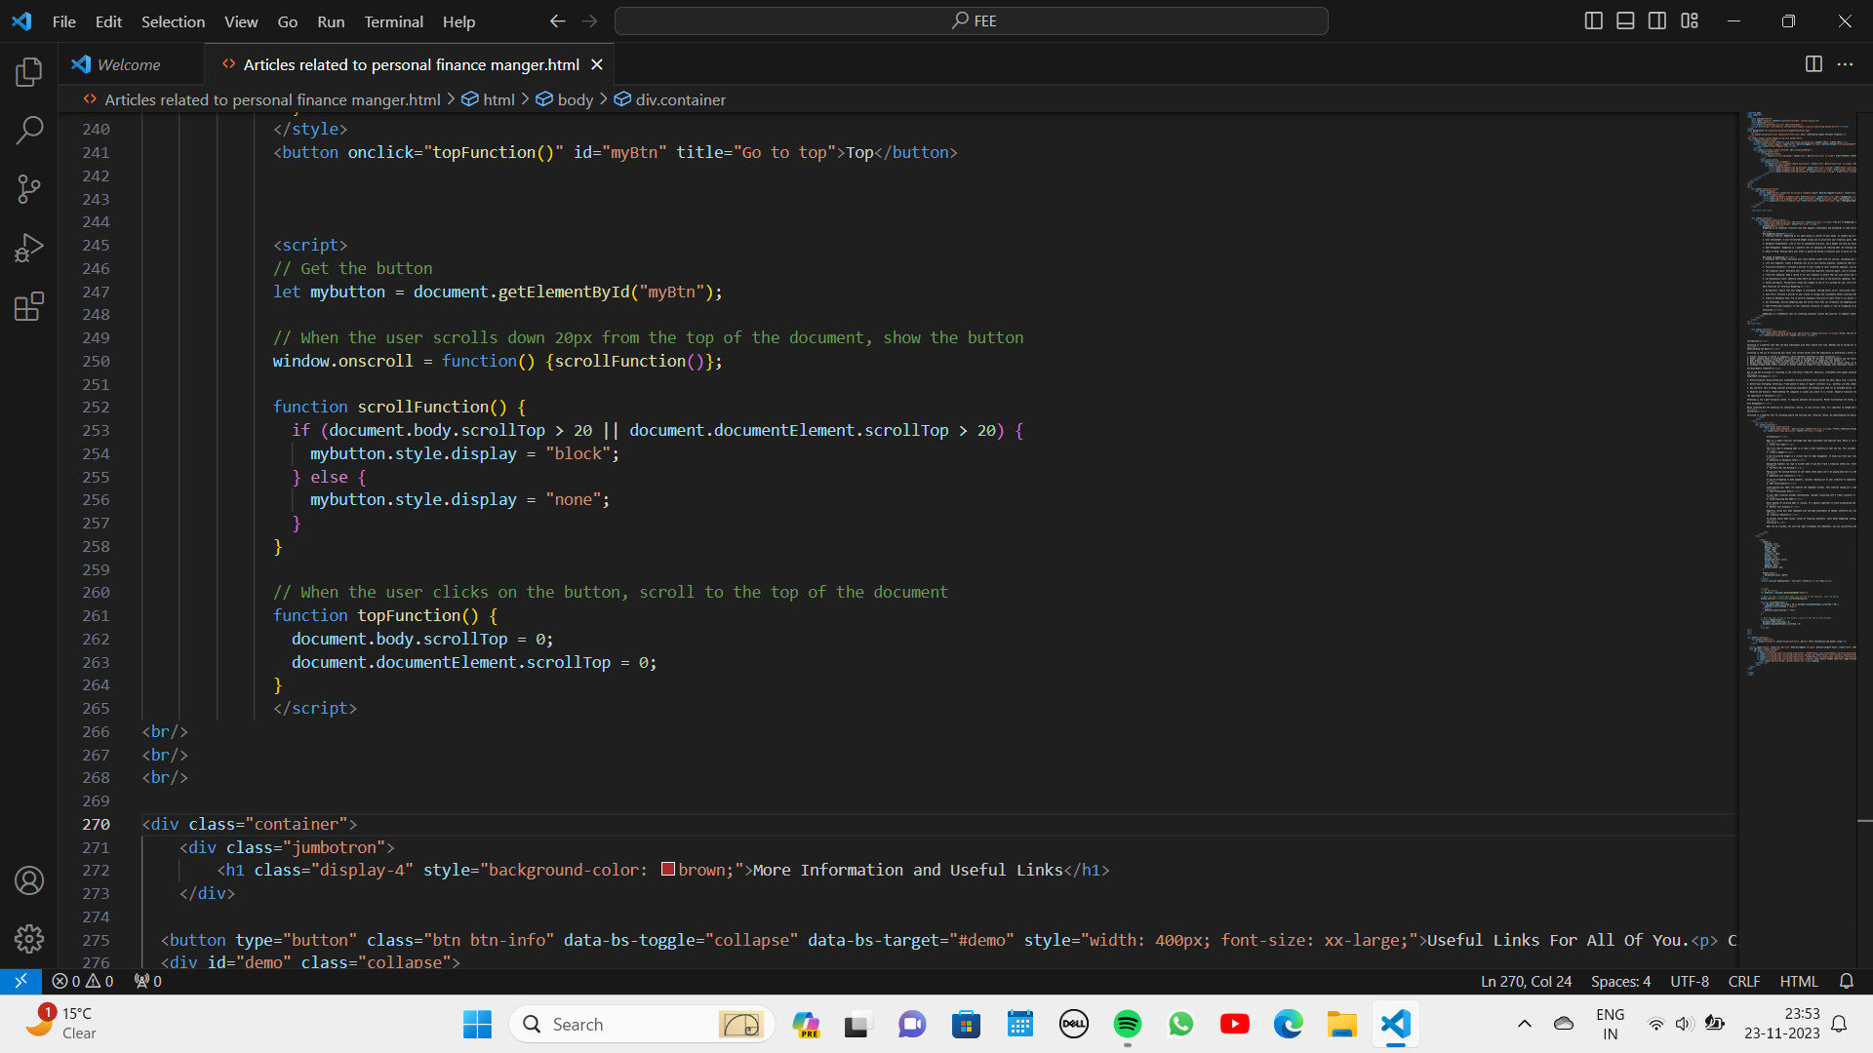

Slide 48
Conclusion
Making a website is really a dream for a computer science student . Also , making website is really fun for a developer.
Similarly , for our team making a website has always been interesting and fun.
Though , we made a lot of mistakes while doing our project , we have learnt of lot about HTML and CSS.
We learnt most important thing that is teamwork which will be beneficial for our future , as we might be handling bigger projects in our future studies.
We learnt the following:
Introduction to HTML
More on HTML
Forms
Introduction to CSS
Styling with CSS
Flex
More on styling
Responsive Design
Modals and Panels
Alerts

Slide 49
Conclusion
Collapsible
Dropdown and Navbar
Breakpoints
Onfocus Event
Onreset Event
Onsubmit Event
Onscroll Event
parseFloat
At the end , making a website is really good experience for a full stack developer.

Slide 50
References/Links used
W3Schools : https://www.w3schools.com/html/default.asp
https://www.w3schools.com/howto/default.asp
https://www.w3schools.com/w3css/default.asp
RenderForest:
https://www.w3schools.com/w3css/default.asp
Canva
https://www.canva.com/create/logos/

Slide 51


